Slide 1


Peer Support: Key to sustaining our wellbeing
Jo Shapiro, MD, FACS, FRCSI (hon)
Associate Professor, Otolaryngology Head and Neck Surgery
Harvard Medical School
Consultant, Dept of Surgery
Massachusetts General Hospital
Principal Faculty, Center for Medical Simulation
Boston, MA

Slide 2
Thank You
TEACH
Carilion Clinic | Virginia Tech Carilion School of Medicine
All of You
Notes:
T

Slide 3

Photo by Jeremy Thomas on Unsplash

Slide 4

For many years, our system has treated
us as an inexhaustible resource –
ignoring our physical/mental/emotional
health
We have internalized this
Photo by NASA on Unsplash

Slide 5

Reflection on Emotional Stressors
Think of a particularly stressful event or circumstance in your professional life. What were some of the emotions you remember feeling?

Slide 6

Adverse events
Communication with patients after AE (disclosure/apology)
Emotionally stressful patient outcomes
Lawsuit
Chronic stress
Being bullied
Patient complaints
NPDB report
Patient aggression: physical, verbal, social media
Photo by KaLisa Veer on Unsplash

Slide 7
Reflection on Emotional Impact of Errors
What are some of the emotions that you experienced after you realized you’d be part of making an medical error?

Slide 8
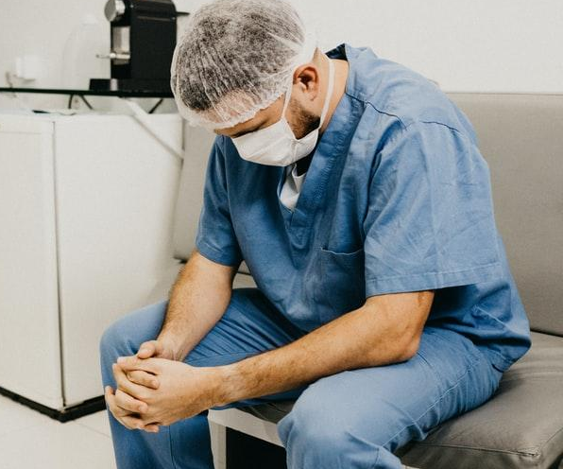
Emotional impact of errors on clinicians
Sadness
Shame
  Self-doubt
Fear
Anger
Isolation
Photo by Jonathan Borba on Unsplash

Slide 9
Please raise your hand if you have never doubted yourself

Slide 10


Helmreich’s observations:
Similarity between medicine and aviation
Photo by Pixabay from Pexels
Photo by Karolina Grabowska from Pexels
“…[both stress] the need for perfection and a deep perception of personal invulnerability…”
Helmreich, Davies.
Culture, Threat and Error: Lessons From Aviation.
Can J Anesth 2004; 51:6

Slide 11

“Healthcare Heroes”
Double-edged sword
Photo by Ricardo Cruz on Unsplash

Slide 12

Culture of Medicine
High value on putting
our head down,
getting our work done:
do your job
It’s not supposed to hurt: walk it off
We usually can fix things
Photo by Hush Naidoo on Unsplash

Slide 13

Emotional impact of errors on clinicians
Sadness
Shame
Fear
Anger
Isolation/loneliness
Photo by EVG Culture from Pexels

Slide 14
Fantasy
No more shame and blame
Safety Culture:
Personal accountability and systems accountability
14

Slide 15
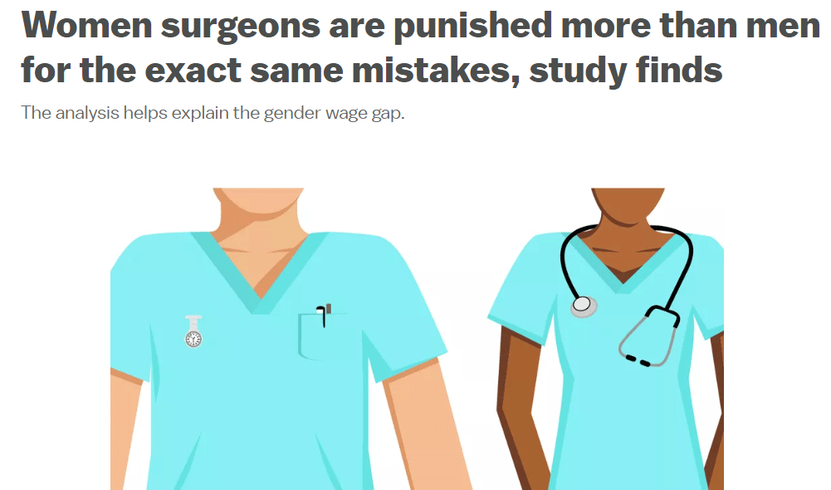
Following patient death
Referrals dropped by 54% for female surgeons
Only a small stagnation of referrals for male surgeons
Harvard working paper. Sarsons H. Interpreting Signals
in the Labor Market: Evidence from Medical Referrals. October 31, 2017

Slide 16
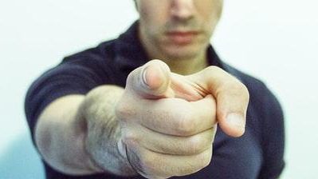
Internal and external regulatory judgment and punishment
Event analysis: M&M, RCA
Department of Public Health
Board of Registration in Medicine
Inspectorate
Royal College of Physicians and Surgeons
Court of law
Media
Photo by Adi Goldstein on Unsplash

Slide 17

Communication & Resolution Programs (CRPs)
Transparent with patients regarding adverse events
  What happened/why
  Was event preventable
  How recurrences will be prevented
Proactive and prompt offer of financial and non-financial resolution if unreasonable care

Slide 18
Emotional impact of errors on clinicians
Sadness
Shame
Fear
Anger
Isolation/loneliness
Photo by Jonathan Borba on Unsplash

Slide 19
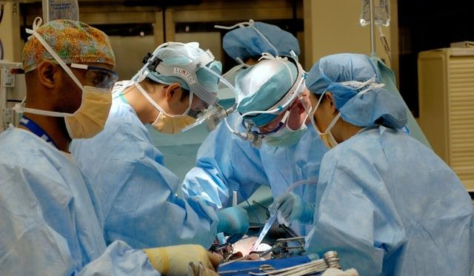

Normal reactions to abnormal events
Photo by National Cancer Institute on Unsplash
19

Slide 20

But sometimes recovery is thwarted…
Photo by Mulyadi on Unsplash
… causing harm to
clinicians and our patients

Slide 21
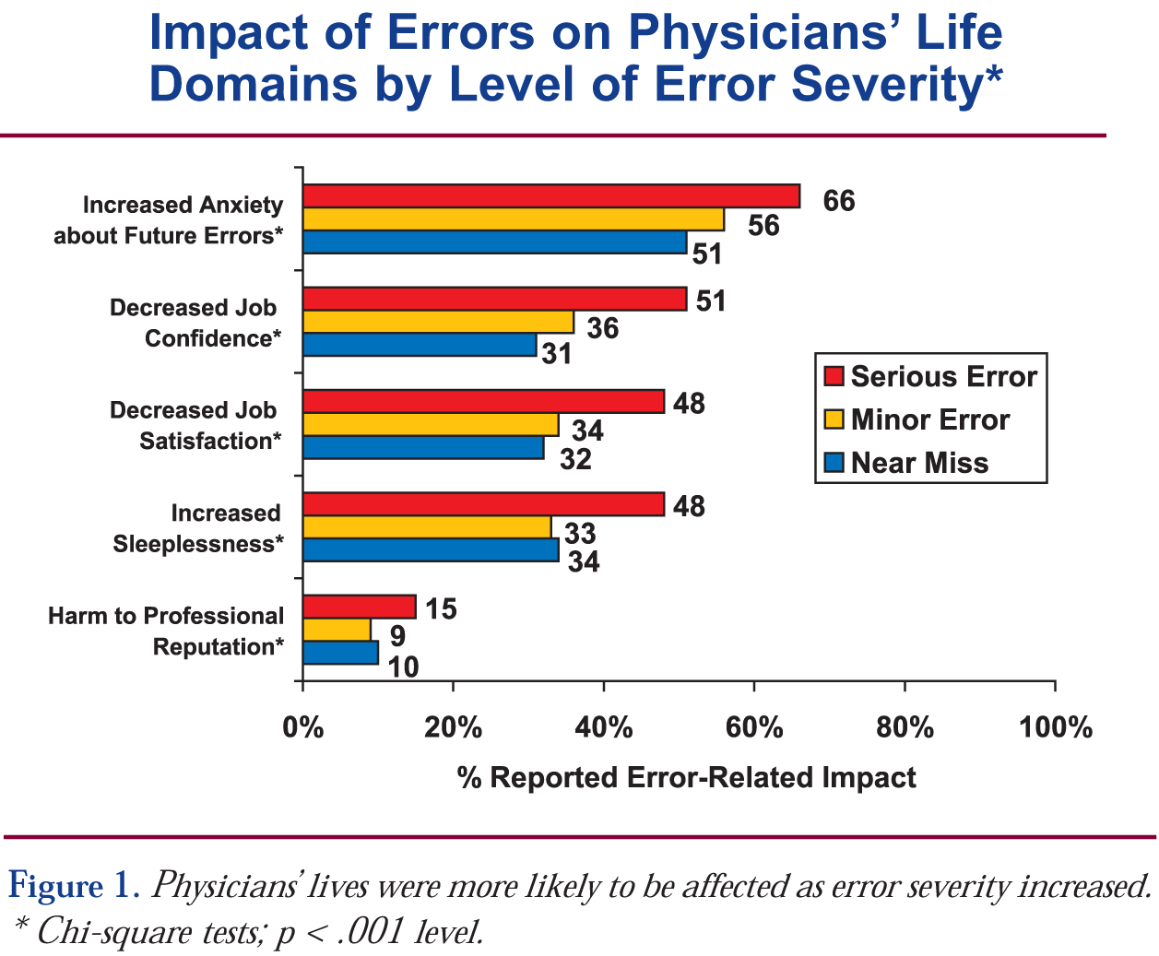
Error impact
3,171 MDs surveyed in US and Canada
Waterman et al. Jt Comm J Qual Patient Saf. 2007 Aug;33(8).

Slide 22
U.S. vs. UK: MDs and RNs
Following medical error
∼30%
Experienced some negative impact on
Work performance or personal life
Colleague relationships
Harrison R, Lawton R, Perlo J, Gardner P, Armitage G, Shapiro J.
J Patient Saf. 2015 Mar;11(1):28-35.

Slide 23
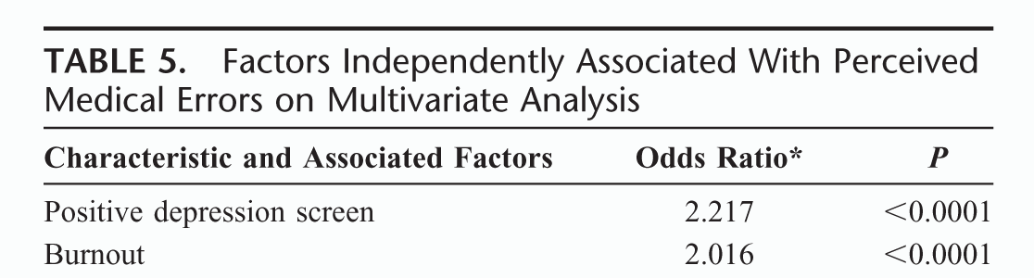
Burnout and Depression
Burnout and depression = independent predictors of reporting a recent major medical error
Shanafelt TD, Balch CM, et al. Ann Surg 2010; 251(6)

Slide 24
Errors
Burnout

Slide 25
Suicidal ideation in MD’s correlates with recent errors
Of MDs reporting recent errors had SI
(n=691)
12.7%
vs.
Of MDs who did not report recent errors had SI (n=5895)
5.8%
Tawfik DS, Profit J, Morgenthaler TI, et al. Mayo Clin Proc. 2018 Jul 9.

Slide 26
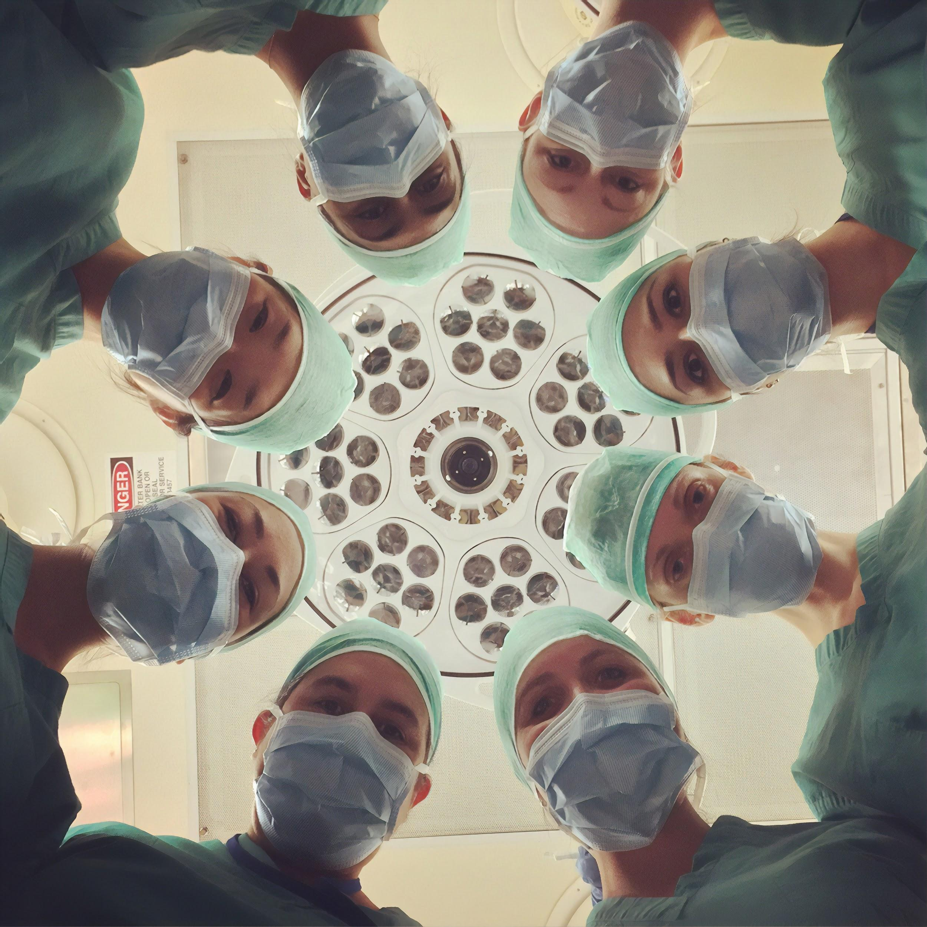
So, how do we facilitate coping and resilience?
Photo by National Cancer Institute on Unsplash
Hu Y, Fix M, Hevelone N, Lipsitz S, et al. Attitudes and needs of physicians for emotional support:
The case for peer support. JAMA Surg 2012
26

Slide 27

Sources of support
Hu Y, et al. JAMA Surg 2012
27

Slide 28

Factors associated with resilience after adverse events
Dealing with
imperfection
Talking about it with colleagues
Learning from the error/ understanding how to prevent recurrences
Disclosure and apology
Forgiveness
Sharing that learning with colleagues and trainees
Photo by Francesco Gallarotti on Unsplash
Plews-Ogan M, May N, Owens J, Ardelt M, Shapiro J, Bell SK. Wisdom in medicine: What helps physicians after a medical error. Acad Med. 2015 Sep 4.

Slide 29



Support Spectrum
INFORMAL PEER SUPPORT
FORMAL PEER SUPPORT
FURTHER PROFESSIONAL RESOURCES

Slide 30
Peer Support Principles
Presence
Psychological safety
Empathic listening: validate
Non-judgmental curiosity
Reflective prompts
Problem solving guidance
Explore coping mechanisms
Reframing
Resource connection
Appreciation

Slide 31

“If you build it, they won’t come”
Photo by National Cancer Institute on Unsplash
Photo by Habib Dadkhah on Unsplash
Shapiro J, McDonald T. Supporting clinicians during Covid-19 and beyond — learning from past failures and envisioning new strategies NEJM/ Oct 2020

Slide 32

Barriers to seeking support
Lack of time (89%)
Stigma (77%)
Lack of confidentiality (79%)
Access (67%)
Hu Y, et al. JAMA Surg 2012
Photo by Ellie Burgin from Pexels

Slide 33
Barriers to Getting Support
We are strong, and strong means denying our own needs
Culture of silence: isolation
Our physical, mental and emotional needs are unimportant as they pale in comparison to our patients’, families’ communities’ and colleagues’
Self-care and self-compassion are selfish

Slide 34
Peer Support ideally is
Reach Out and Proactive
Unfair to put burden on individual clinicians to seek help
Don’t wait until clinicians manifest stress
Integrate into current clinical processes/culture

Slide 35
Vulnerability = Courage
Integrate that into every aspect of what we do

Slide 36
When should we offer peer support?
Adverse events
Communication with patients after AE (disclosure/apology)
Emotionally stressful patient outcomes
Lawsuit
Chronic stress
Being bullied
Patient complaints
NPDB report
Patient aggression: physical, verbal, social media
Photo by KaLisa Veer on Unsplash

Slide 37
Peer support:
A powerful culture change tool
Shame and blame |  | Promotes Just Culture
Personal invulnerability |  | Human factors
Expectation of emotional denial |  | Normalizes reactions
Isolation |  | Community/solidarity
Self care is selfish |  | Gets you back to what you do well
Helps us show up with compassion
for our patients, each other and ourselves

Slide 38
Not Victims
“we are not victims of that world, we are its co-creators.
…source of awesome responsibility…and profound hope for change.”
Palmer, P. Let Your Life Speak, Jossey-Bass,
San Francisco, CA, 2001.

Slide 39
Zandashe L’Orelia Brown
(twitter – May 18, 2021)
I dream of never being called resilient again in my life.
I’m exhausted by strength. I want support. I want softness. I want ease. I want to be amongst kin. Not patted on the back for how well I take a hit. Or for how many.
Instead of hearing “You are one of the most resilient people I know,” I want to hear “You are so loved.” “You are so cared for.” “You are genuinely covered.”

