Slide 1
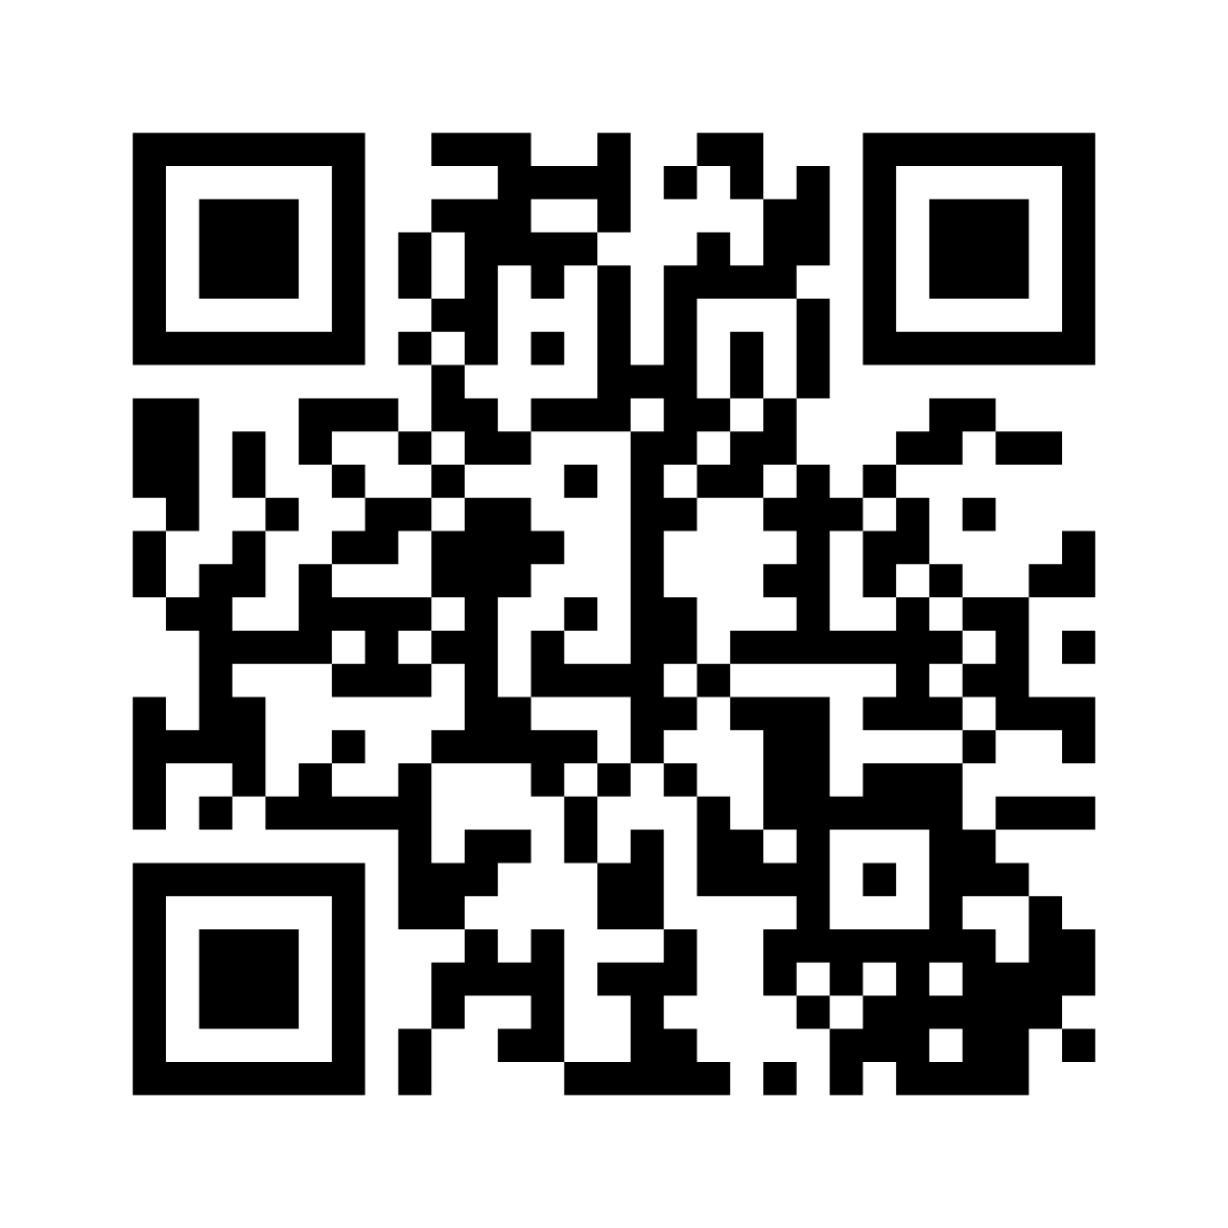
What are some barriers to education for medical students with disabilities?
Visit menti.com
Enter code 3925 6223

Slide 2
ABLEISM
discrimination in favor of able-bodied people
Permission and Credit: Jamie Shields

Slide 3
Systemic barriers for students with disabilities
Home
K-12
Higher Education
Undergraduate Medical Education
Graduate Medical Education
Continuing Medical Education
Medical Education Continuum

Slide 4
Systemic barriers
DSRP: DISTINCTIONS, SYSTEMS, RELATIONSHIPS, PERSPECTIVES
Multiple systemic connections around barriers for disabilities
Distinction: different, “other than”, disclosure
Systems: funding, healthcare, technology, access, prioritization
Relationships: inclusion vs exclusion, belonging vs outsider
Perspectives: societal beliefs, attitudinal barriers

Slide 5
Accessibility & Inclusion in Teaching Across the Medical Education Continuum
“Going Beyond ”
Vianne Greek, MBA, CPWA
Director of Digital Initiatives for Medical Education
Virginia Tech Carilion School of Medicine
Virginia Tech
David Halpin, PhD
Instructional Designer & Trainer
Center for Innovative Teaching & Learning
Radford University Carilion

Slide 6
Learning objectives
List and compare three categories of disabilities.
Define the terms accessibility, accommodation, diversity, and inclusion.
Employ two strategies for creating content that reflect your learners’ unique identities and experiences.

Slide 7
Accessibility

Slide 8
Categories of disability
Physical disability | Cognitive disability | Chronic illness
ACCESS | UNDERSTANDING | ENERGY

Slide 10
Save time: include accessibility during design phase
If you neglect accessibility and Universal Design for Learning principles in the planning phase, you’ll need to provide accommodations in the implementation phase
Less time available
Less room to be creative

Slide 11
Definitions: Accessibility
Accessibility: the practice of creating materials and environment so that they are able to be accessed by people with disabilities.

Slide 12
Definitions: Accommodations
Accommodation: an academic adjustment to the learning environment, curriculum, or the use of auxiliary aids that allow students with disabilities to have equivalent access to education as nondisabled students.
Accommodations generally only benefit affected students.

Slide 13
Definitions: Universal Design for Learning
Universal Design for Learning: create inclusive learning environments that reduce barriers, accommodate diverse learner needs, and provide all students with equal opportunities to succeed.
Incorporating UDL benefits ALL students

Slide 14
Common accommodations in didactic setting
Extra time
Distraction free exam space
Alternative formats
Note taker
Notes provided before lecture
Assistive technologies such as Glean, Read & Write, Text to Speech, etc.
Periodic breaks for physical/cognitive wellbeing
Allowances for absence due to flare-ups
Use of a stool during labs
Alternative options for participation / assignment completion

Slide 15
Reduce common accommodations with UDL/accessibility
Extra time - eliminate time restrictions?
Distraction free exam space
Alternative formats
Note taker - designate a note taker in all classes?
Notes provided before lecture
Assistive technologies such as Glean, Read & Write, Text to Speech, etc.
Periodic breaks for physical/cognitive wellbeing
Allowances for absence due to flare-ups
Use of a stool during labs
Alternative options for participation / assignment completion

Slide 16
Common accommodations
Distraction free exam space
Assistive technologies such as Glean, Read & Write, Text to Speech, etc.
Allowances for absence due to flare-ups

Slide 17
Knowledge Check
Categories of disability
Accessibility / UDL

Slide 18
Reducing barriers: lab setting
Personal assistants
Equipment and ergonomics
Visual aids such as magnification
Special furniture
Alternates for chemical sensitivities and allergies
Auditory aids
Simulations
Planned breaks

Slide 19
Reducing barriers: clinical and clerkship setting
Schedule a pre-rotation visit with the student
Location distance
Address any physical accessibility issues
Check for bias / attitudinal beliefs for clerkship staff
Access assistants or intermediaries
Adjust rotation order
Modified schedule (e.g. overnight rotation > weekend shifts)
Live captioning or ASL interpreter on site
Service animals are a right - not an accommodation

Slide 20
Reducing barriers: graduate medical education
Accessibility for physical environment
Ensure that tools and technologies are accessible
Flexible scheduling
Clear, transparent, and consistent accommodations policies
Address biases related to competency of residents with disabilities
Inclusive career advancement criteria
Mentorship programs to support residents with disabilities
Develop a culture for open communication and reducing stigma

Slide 21
Reducing barriers: continuing medical education
Advocate for standardized and accessible credentialing processes
Physical accessibility for conferences
Digital accessibility for virtual experiences
Clear accommodations policies
Flexible scheduling / attendance options
Provide financial assistance for physicians with disabilities
Actively promote diversity and inclusion in CME planning committees
Foster a culture of acceptance and inclusion within the medical community

Slide 22
References and resources
References and resources will be provided on the TEACH website in the near future.

Slide 23
Inclusion

Slide 26
Diversity
Individual differences (e.g. life experiences, learning and working styles, personality types) and group/social differences (e.g. race, socio-economic status, class, gender, sexual orientation, country of origin, ability, intellectual traditions and perspectives, as well as cultural, political, religious, and other affiliations) that can be engaged to achieve excellence in teaching, learning, research, scholarship, and administrative and support services.

Slide 27
Inclusion
The active, intentional, and ongoing engagement with diversity -- in people, in the curriculum, in the co-curriculum, and in communities (e.g. intellectual, social, cultural, geographic) with which individuals might connect.

Slide 28
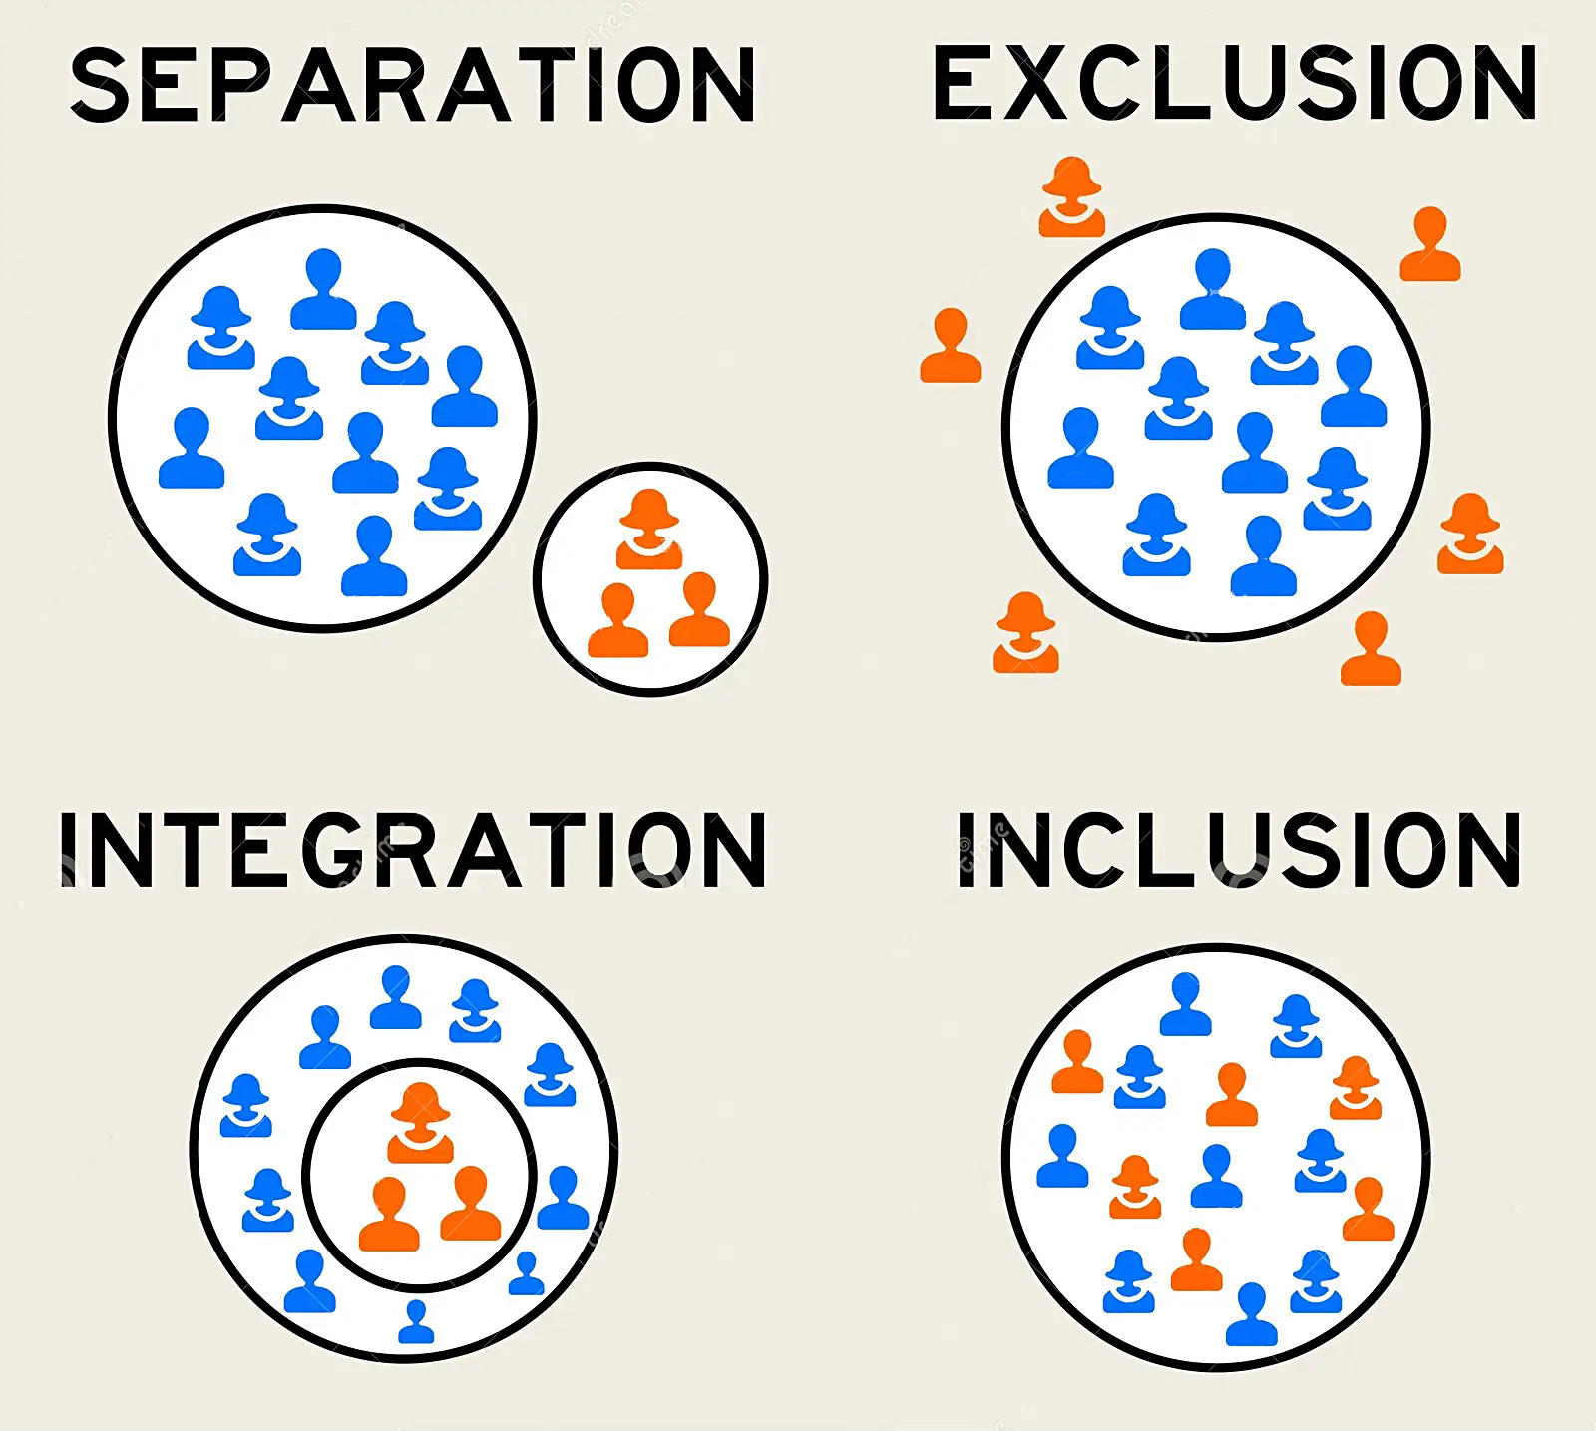
There are no “Others”.

Slide 29
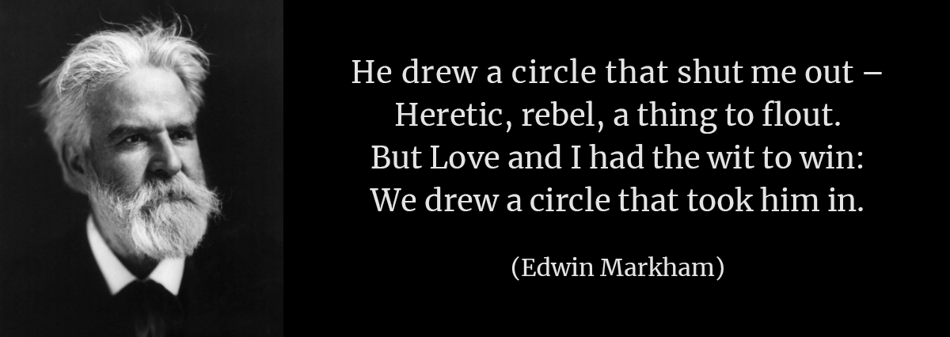

Slide 30
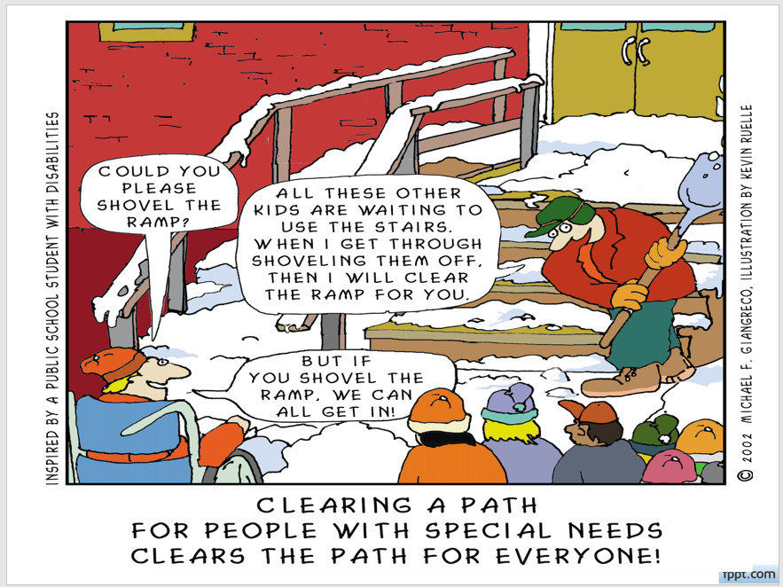

Slide 31
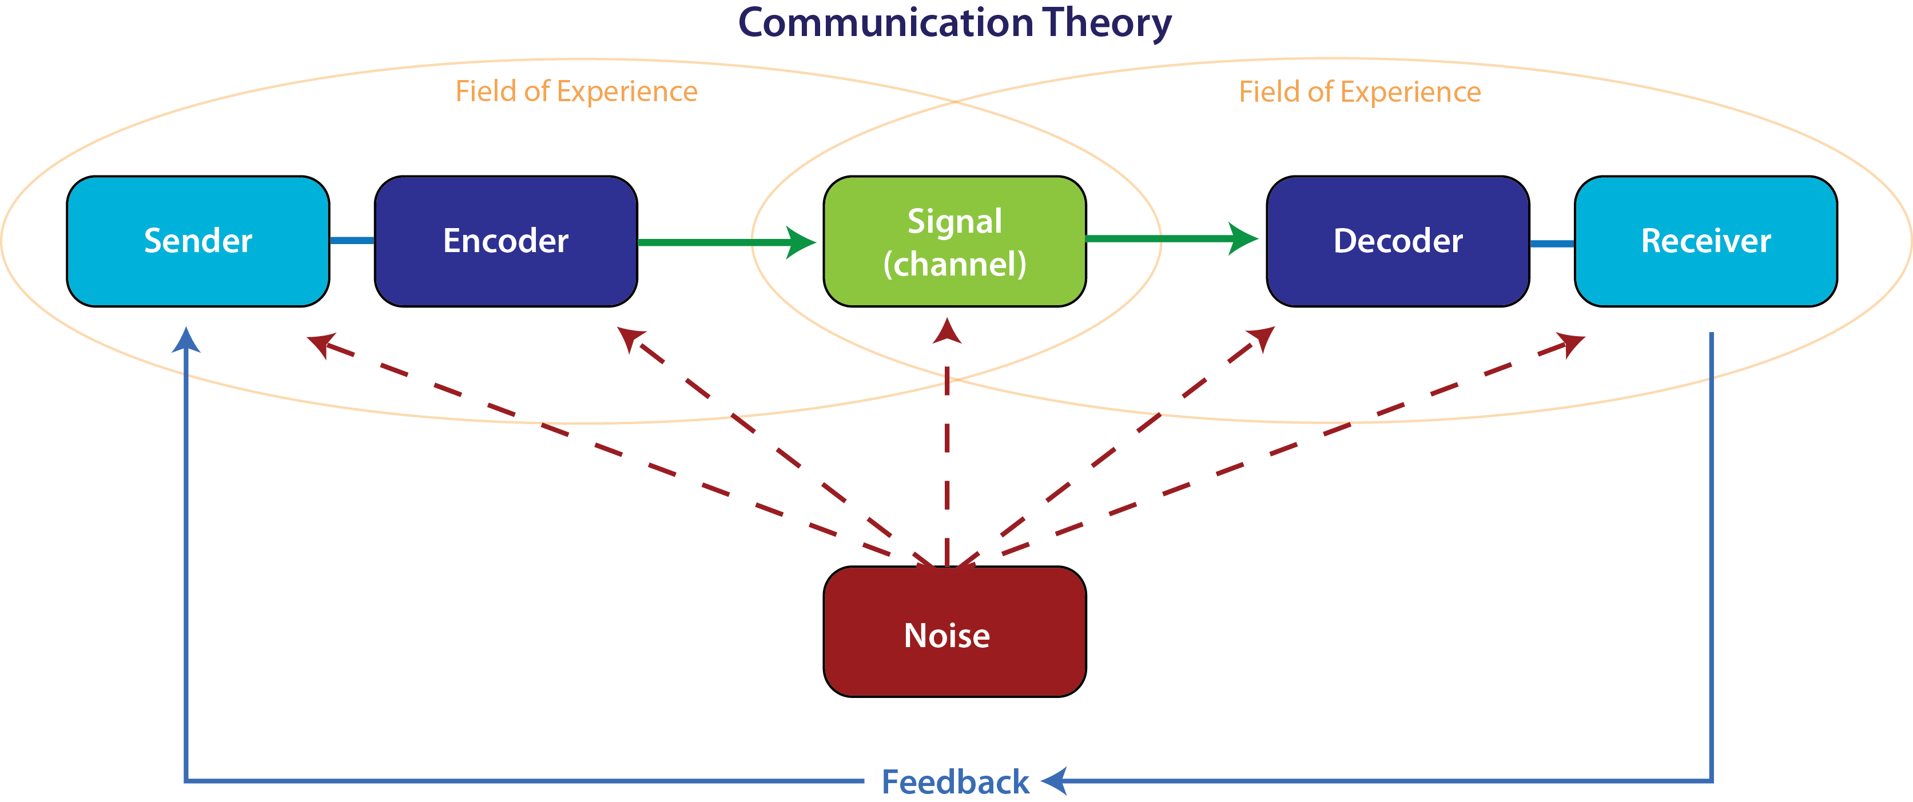

Slide 33
Inclusive Design
“Design that considers the full range of human diversity with respect to ability, language, culture, gender, age and other forms of human difference.”

Slide 34
Prior to Your Experience
Try to understand your learners' characteristics, backgrounds, prior knowledge and experiences, and potential needs.
By assessing their requirements, we can design learning materials that meet the needs of diverse learners.

Slide 35
When Creating Activities
Make expectations clear
Clear deadlines
Or, reassess deadlines
Multiple opportunities for feedback
Reminders, announcements

Slide 36
When Creating Activities
Create diverse learning materials that incorporate multiple perspectives, examples, and case studies.

Slide 37
When Creating Activities
Using diverse images, videos, and graphics helps learners see themselves reflected in the learning materials, improving their engagement and motivation to learn.

Slide 38
When Creating Activities
Create activities that provide learners with options.
Perhaps they can choose topics related to an identity of theirs.

Slide 39
Plus-One Thinking
For every interaction you create, offer one more way for learners to get that same information.
Graphical process flow with click to reveal text callouts > add a video that demonstrates the process in real time.
High-bandwidth content that might eat up your learner’s bandwidth > offer a downloadable text document too.
A video with audio narration > add a transcript or closed captions.

Slide 40
During Your Learning Experience
Provide opportunities for learners to share something about themselves, to include a part of their identity into what they are doing.
You can then learn more about their lived experiences.
See them as complex human beings

Slide 41
During Your Learning Experience
Always approach the experience with the idea that it is in constant revision
Every learner question should be saved.
Use current examples/references
Make them relevant to your learners.
Be careful of jokes, cultural references.

Slide 42
During Your Learning Experience
Foster a welcoming, supportive, and safe space where all learners feel accepted and valued.
Facilitate peer work
Create activities that require participation from everyone
Encourage interactions
Include everyone

Slide 43
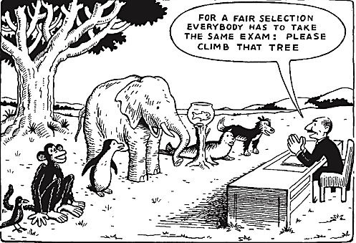
Assessment
If possible, provide multiple means of assessment.
Authentic assessment is preferred.

Slide 44
Online Courses
Make sure you are present in the course frequently
Build community
Consider any technological barriers with your learners

Slide 45
Technology Barriers
Digital divide / Digital exclusion
Those who face exclusion:
People living in poverty
Older adults
People with disabilities
Nonnative English speakers
Those living in remote or rural areas

Slide 46
Troublesome (non-inclusive) Language
Brown bag lunch
Freshman
Anchorman, Chairman, Fireman, Garbage Man, Handyman, etc.
Blacklist
White glove

Slide 47
Troublesome (non-inclusive) Language
Illegal alien
Circle the wagons
Powwow
Ignoring pronouns and preferred names
Stand up meetings

Slide 49
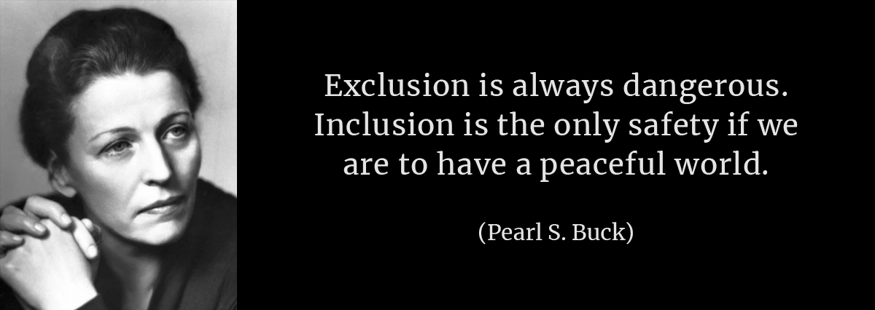

Slide 50
Accessibility & Inclusion in Teaching Across the Medical Education Continuum
“Going Beyond ”
Vianne Greek, MBA, CPWA
Director of Digital Initiatives for Medical Education
Virginia Tech Carilion School of Medicine
Virginia Tech
David Halpin, PhD
Instructional Designer & Trainer
Center for Innovative Teaching & Learning
Radford University Carilion

