Slide 1
Population health and social determinants in health and health care
Cynthia B. Morrow, MD, MPH*
Aaron Boush, MHA*
June 2021
* We have no relationships with industry.

Slide 2
Overview
Goal for this session
  To improve your understanding of population health, social determinants of health, health equity, health disparities, and disparities in health care
Specific objectives:
Define health equity, health disparities, and disparities in health care
Identify major determinants of health including behavioral, social/ economic, environmental, and clinical care determinants of health
Describe the role of healthcare systems and the role of physicians in addressing health and healthcare disparities to improve population health
Provide at least two examples of how Carilion Clinic’s Community Health and Outreach Partnerships improve health in the Roanoke Valley

Slide 3
Let’s start with definitions
POLL #1

Slide 4
Population health
For the purposes of our discussion this refers to as:
“The health of the population. Public health professionals use population health to refer to health of the entire population in a geographic area whereas health care or health insurance providers may use it to refer to their population of patients or insured persons, not the whole community.”
From Birkhead, Morrow, and Pirani “Essentials of Public Health”

Slide 5
Population health management
For the purposes of our discussion this refers to as:
“Management of both the cost and the health outcomes of specific patients served by a healthcare delivery system or by an insurer.”
From Birkhead, Morrow, and Pirani “Essentials of Public Health”

Slide 6
Equality, equity, and social Justice
Organization for Economic Cooperation and Development (OECD)Twitter 10/31/2018

Slide 7
Health equity: W.H.O.
“Equity is the absence of avoidable, unfair, or remediable differences among groups of people, whether those groups are defined socially, economically, demographically or geographically or by other means of stratification.
Health equity implies that ideally everyone should have a fair opportunity to attain their full health potential and that no one should be disadvantaged from achieving this potential.”

Slide 8
Health Disparities: W.H.O.
Disparities are the metric by which we measure health equity.
They are “(t)he differences in health status or in the distribution of health resources between different population, arising from the social conditions in which people are born, grow, live, work, and age.
Disparities are unfair and could be reduced by the right mix of government policies.”

Slide 9
Healthcare Disparities: AHRQ
The “differences in access to or availability of medical facilities and services, and variation in the rates of disease occurrence and disabilities between population groups defined by socioeconomic characteristics such as age, ethnicity, economic resources, or gender and populations identified geographically.

Slide 10
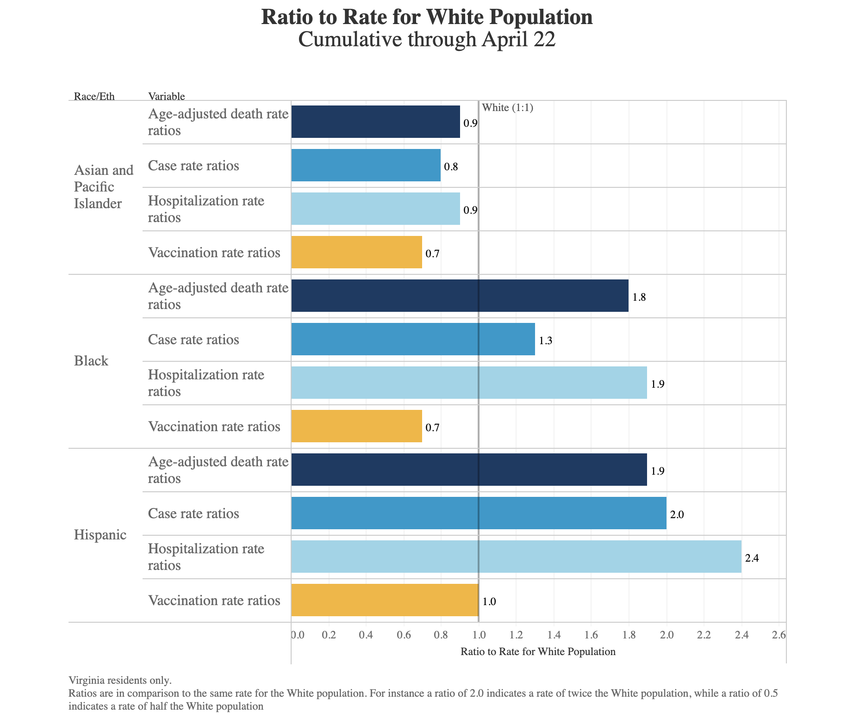
COVID as an example in Virginia: COVID-19

Slide 11
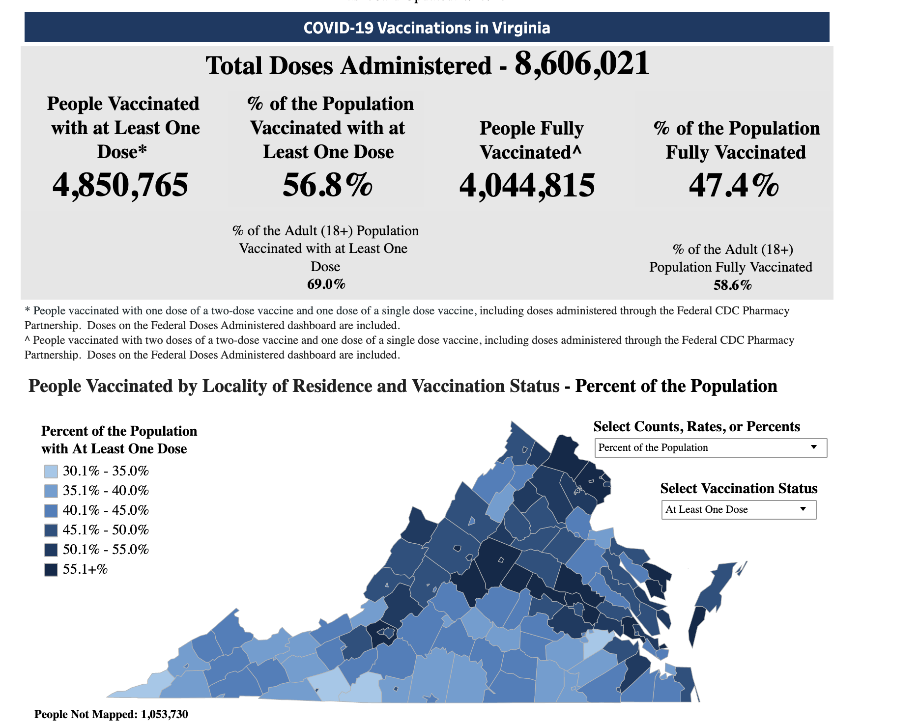
Taking a Look at COVID-19 vaccinations 6/13/2021

Slide 12
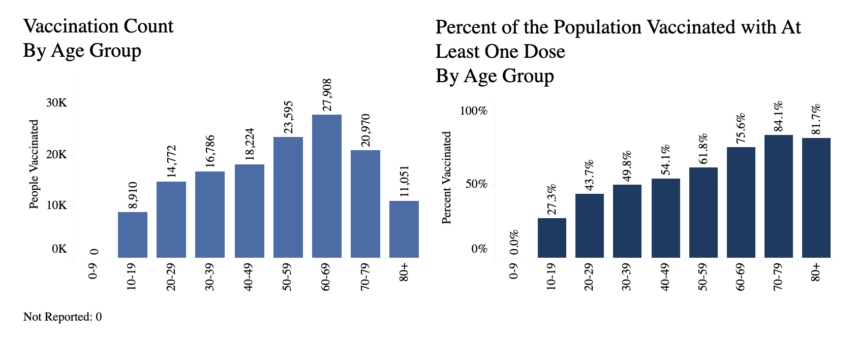
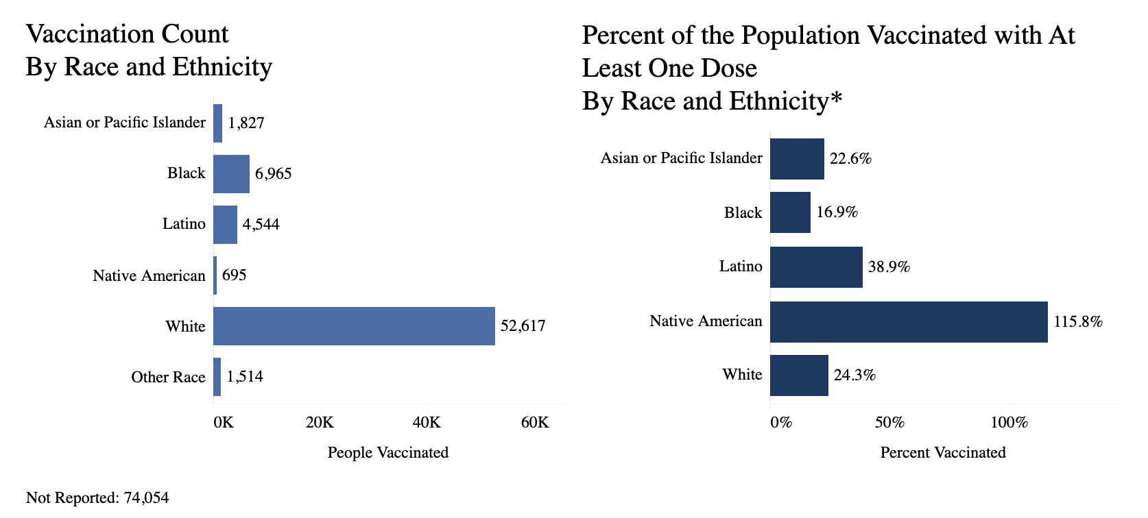
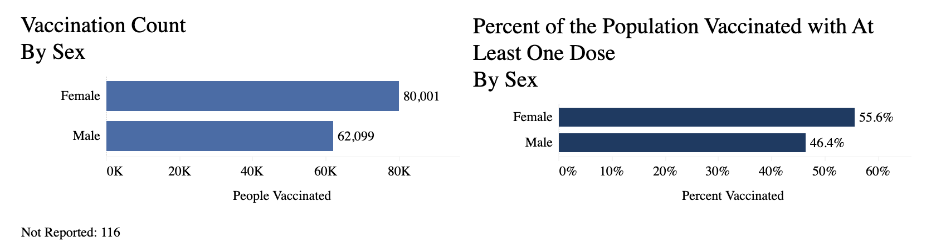
Taking a Look at COVID-19 vaccinations in the RCAHD* 6/13/2021
*Serving:
Alleghany County, Botetourt County, City of Covington,
Craig County, Roanoke City, Roanoke County, City of Salem

Slide 13
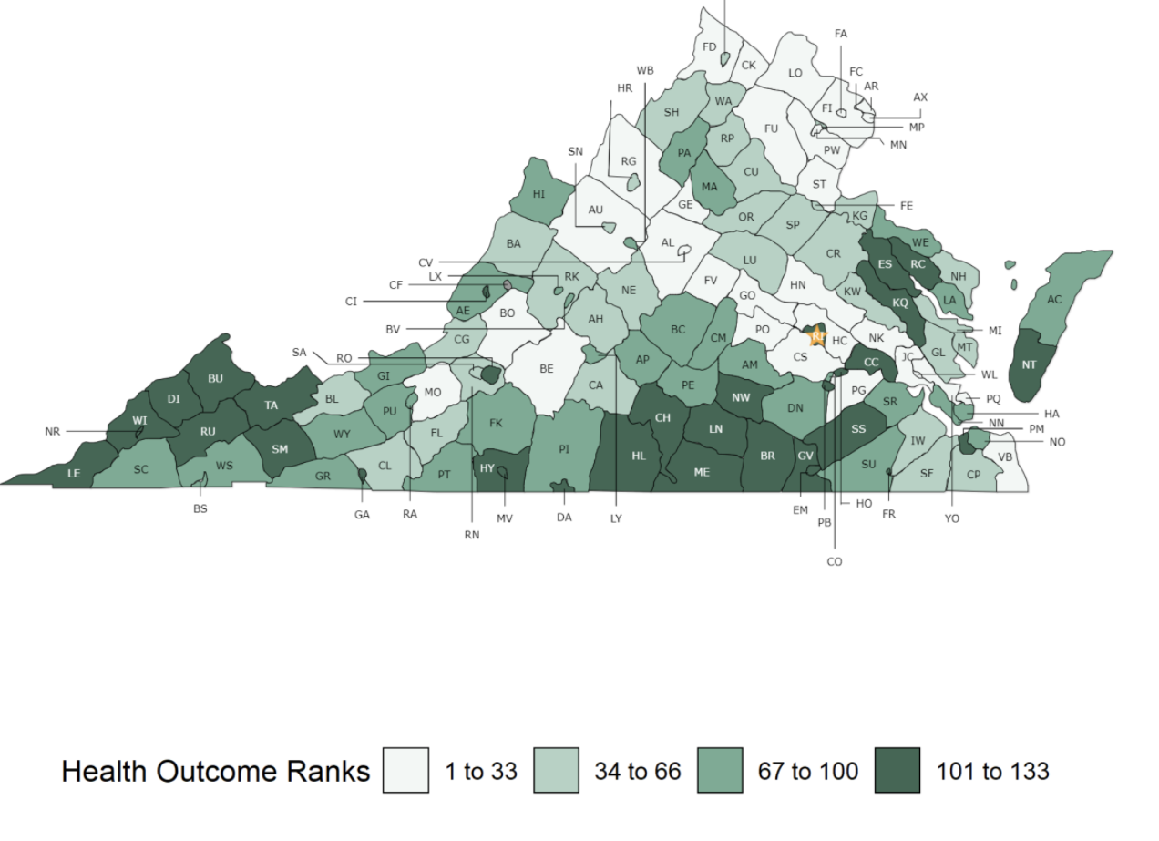
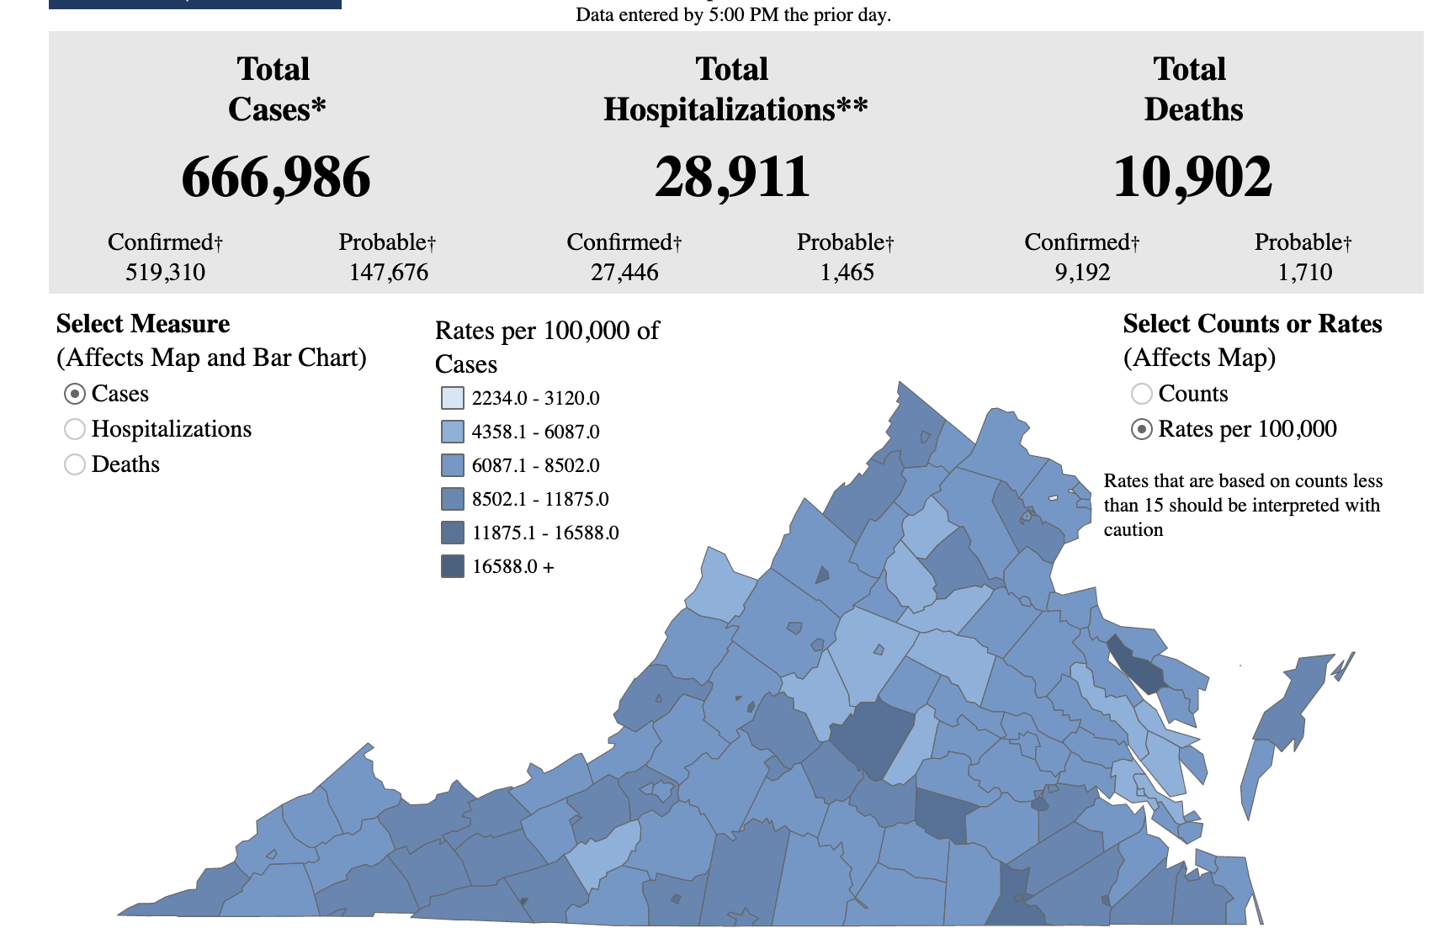
County Health Rankings 2021
Overarching Health disparities in VA
Alleghany 84
Botetourt 18
Covington 131
Craig 51
Roanoke City 110
Roanoke County 34
Salem 47
POLL #2

Slide 14
What influences Health?
Length of life: Premature deaths (deaths <75 years)
Quality of life:
Health-related quality of life
Diabetes, HIV
Low birth weight
RWJF
What is missing from this model?

Slide 15
Income inequity

Slide 16
Education Inequity

Slide 17
Place correlates with Health
Common saying in public health: Your zip code is a better predictor of health than your genetic code….
R. Chetty “Life expectancy for individuals with low incomes is lowest in Nevada, Indiana, and Oklahoma and highest in California, New York, and Vermont.”
POLL #3

Slide 18
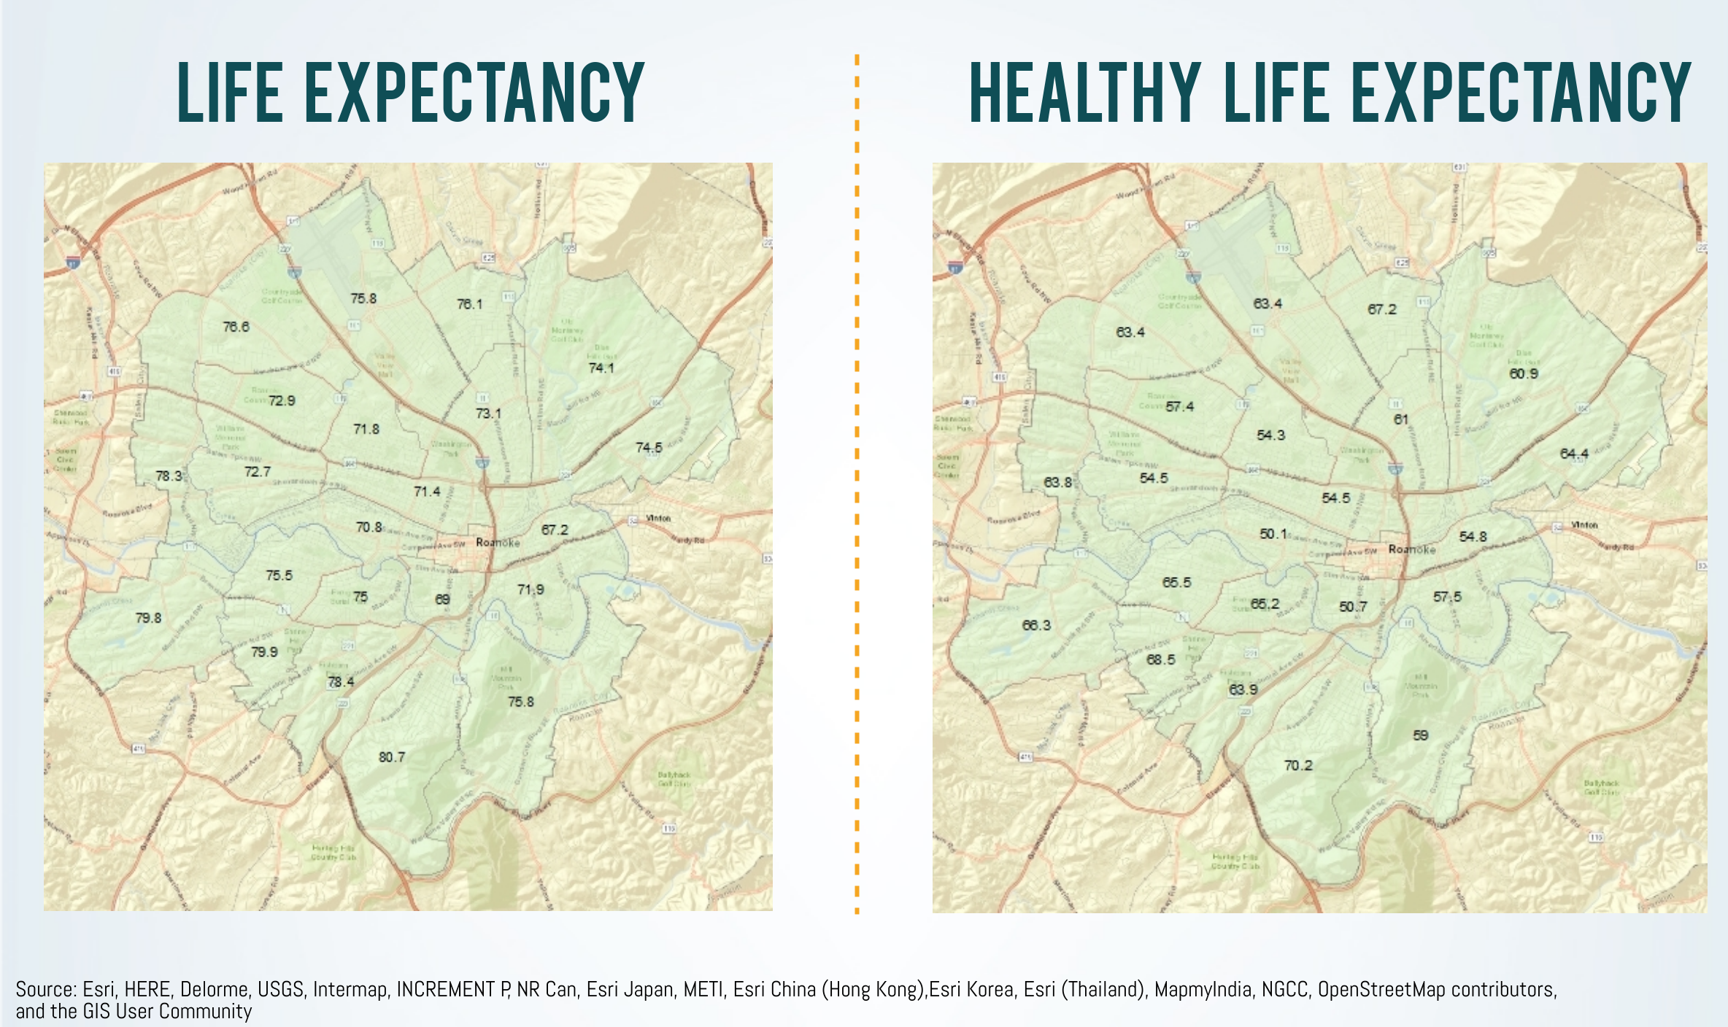
Thanks to Aaron Bousch for this slide.

Slide 19

Moving to Clinical care Determinants of health
What are key clinical determinants of health?

Slide 20
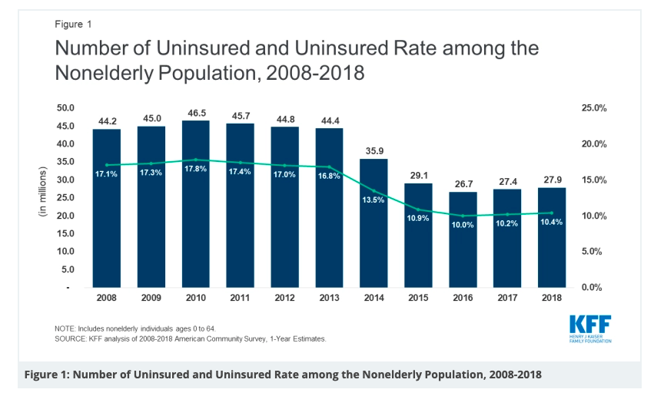
Access to care: Cost
Cost
  Insurance status
    Co-pays
    Deductibles

Slide 21
Access to care: Health Care provider
Responsiveness
  Timeliness (also of health care system in which the provider works)
Trust
  Communication skills
  Cultural humility
Language

Slide 22
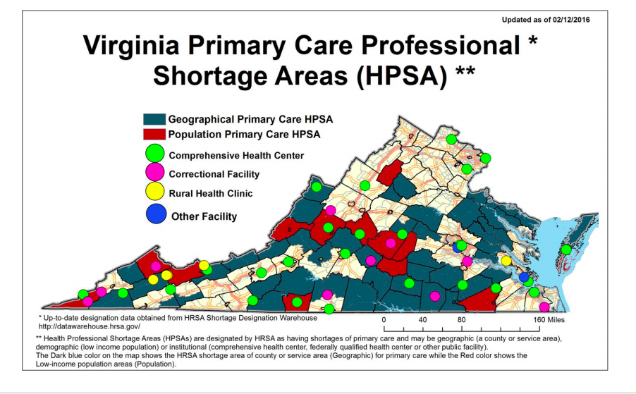
Access to care: Services
  Availability
    Rural/ Urban
    Primary care
    Mental health services
    Specialty care
  Acceptance of insurance
  Acceptability

Slide 23
Quality of care:
Preventive Services
Percentage of Adults Aged 50 to 75 Years Who Reported Being Up-to-Date with Colorectal Cancer Screening, by State, BRFSS 2016
Preventive services (ACA no co-pay)
  Screening
  Immunizations
  Chemoprophylaxis
CDC

Slide 24
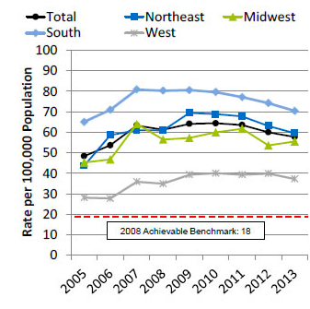
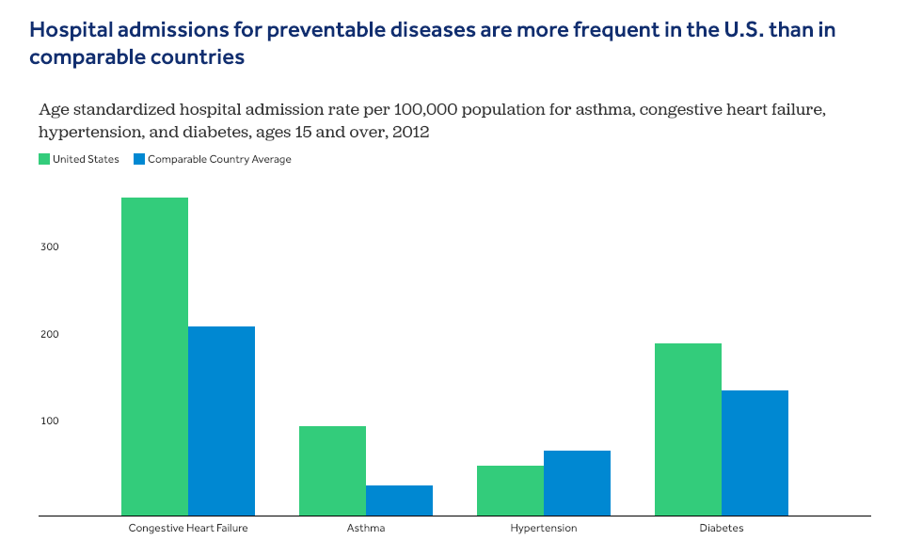
Quality of care: appropriate treatment
Admissions with hypertension, by region, 2005-2013. AHRQ.
Preventable hospitalizations/ED visits
  “Hospitalization for diagnoses treatable in outpatient services suggests that the quality of care provided in the outpatient setting was less than ideal. The measure may also represent a tendency to overuse hospitals as a main source of care.”
    County Health Rankings
Treatment outcomes
  30-day mortality rates

Slide 25
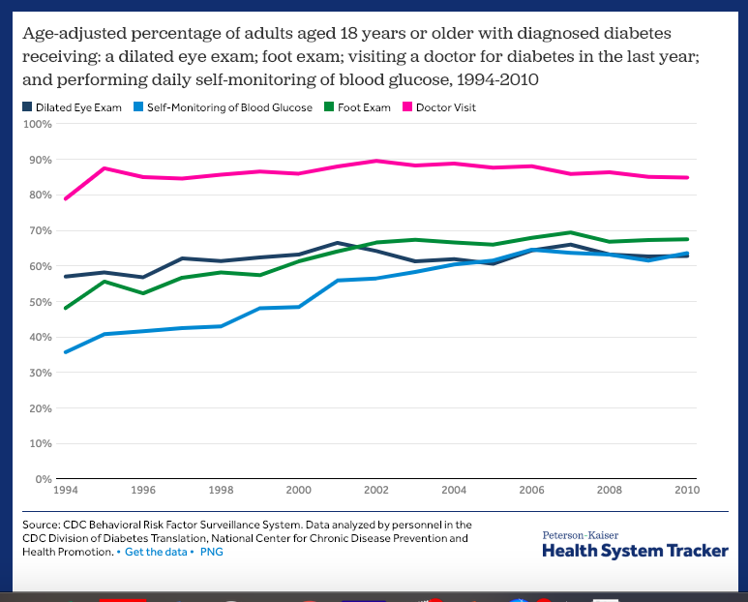
Quality of care:
Adherence to recommended follow-up
Diabetes
Hypertension
HIV

Slide 26
Inequity in health care
“Unequal Treatment: Confronting Racial and Ethnic Disparities in Health Care”
Institute of Medicine, 2003
  >170 studies documenting racial and ethic disparities in diagnosis and treatment in health care
  Even when controlled for social determinants of health (insurance status, education, income, and so forth)
  MANY many factors contribute to these inequities

Slide 27

Current Status
Annual report on disparities by race/ ethnicity, poverty status, and geography

Slide 28
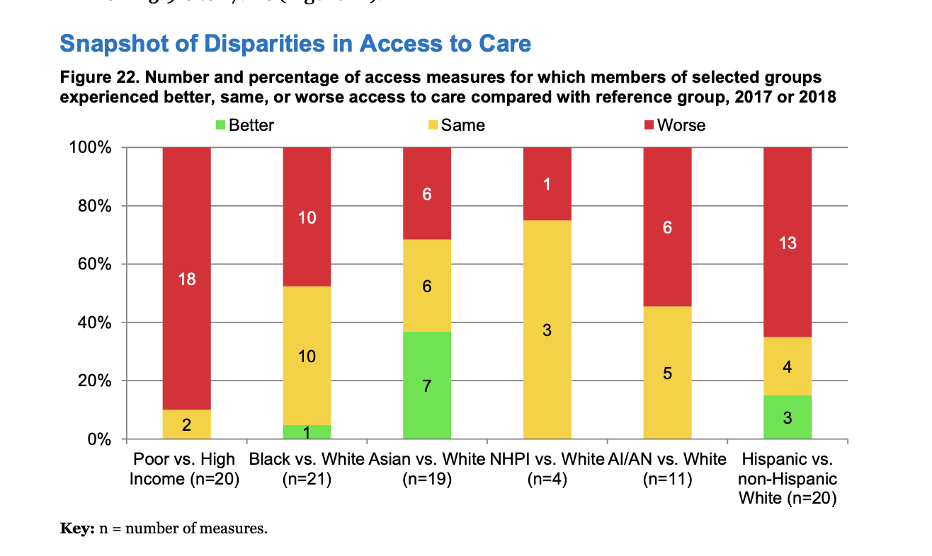
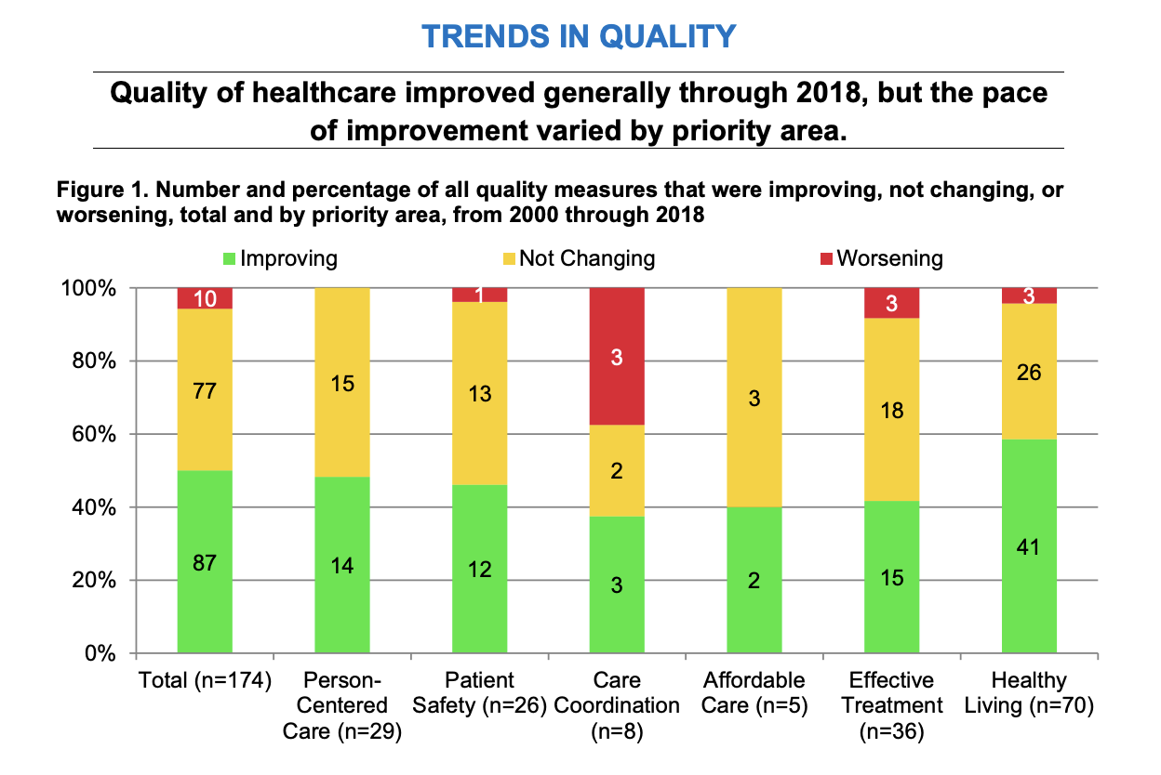
Disparities: Overall, some disparities were getting smaller from 2000 through 2016-2018, but disparities persist and some even worsened, especially for poor and uninsured populations in all priority areas.

Slide 29
Guiding principles to address disparities?
Relationship centered
Culturally and linguistically diverse
Targeted focus
Transparent
Long and short term goals
Collaborative
Comprehensive
Fiscally responsive
MONITOR and REVISE
Notes:
Ama policy statement guiding principles that drive strategies locally, state, federal level in policy

Slide 30
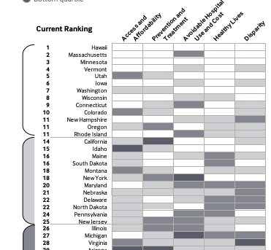
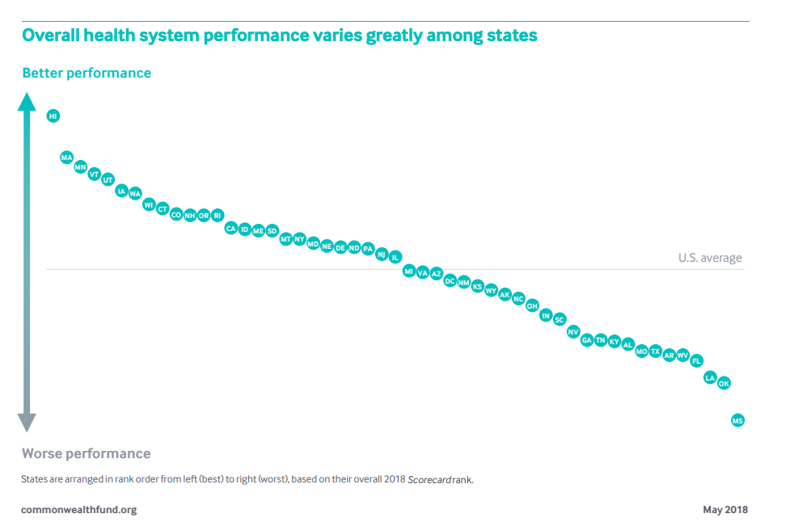
Commonwealth Fund

Slide 31
Why should you care? Why is it important?
In addition to improving outcomes…
Physicians and healthcare delivery systems are increasingly being held accountable for addressing determinants of health
Integral to the shift to value-based care is payment for that care

Slide 32
What is a Systems Citizen?
At the end of the day, health professionals have two jobs:
  Deliver high quality, high value care to patients
  Improve the processes and outcomes of care
    Within the health system in which you work
    Within the community in which you live

Slide 33
A changing system:
Volume based to value-based care
CMS:
  Successful efforts to improve social determinants of health and access to appropriate healthcare rely on deploying evidence-based interventions through strong participations between local healthcare providers, public health professionals, community and social service agencies and individuals.
  Many drivers of health care costs fall outside the clinical care environment: Social/ economic determinants, health behaviors, and the physical environment

Slide 34
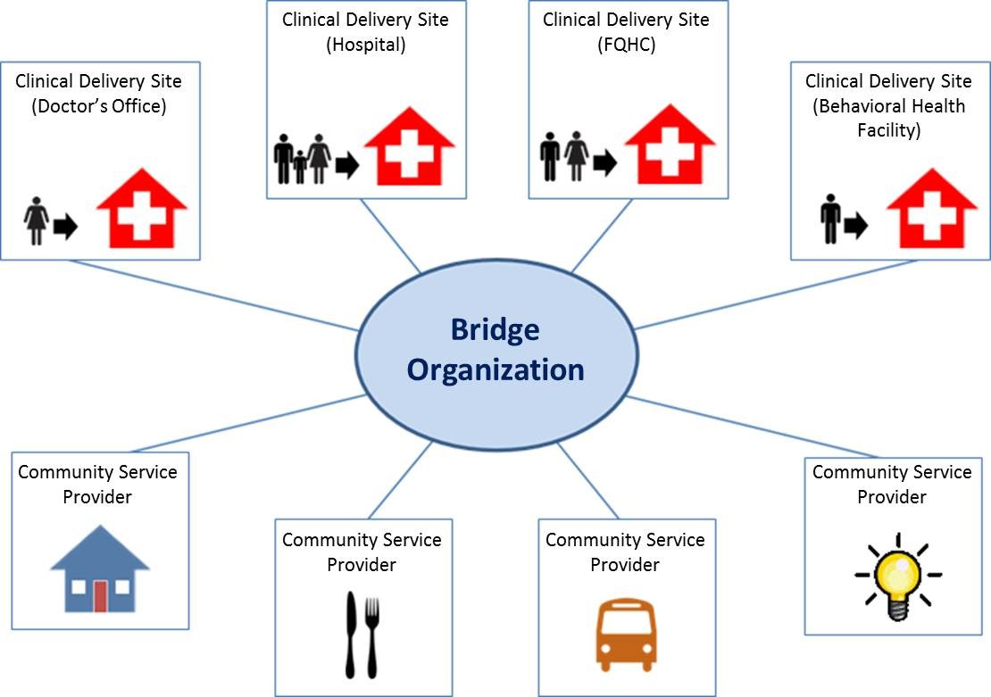
Health-Related Social Needs
Housing instability
Utility needs
Food insecurity
Interpersonal violence
Transportation
Supplemental: Family/social support, education, employment/income/ health behaviors

Slide 35
Collect and analyze data by patient race, ethnicity, and language.
To improve health equity, organizations first need to understand where disparities exist.
They can start by developing reliable systems to accurately, uniformly collect data of race, ethnicity, and language (REAL) data, along with the resources to analyze it.
Look for data in access, service utilization, quality, safety and outcomes.

Slide 36
Center at the margins: begin improvement work by considering the needs of the disadvantaged
Make improvements for patients with less complex needs.
Implement the improvements for patients with more complex needs.
Improvement work needs to be designed from the start to meet the needs of marginalized populations — known as “centering at the margins” — rather than taking a generic, “one size fits all” approach.

Slide 37
Use the required Community Health Needs Assessment as an opportunity.
Under the Affordable Care Act, the IRS requires not-for-profit hospitals to conduct a Community Health Needs Assessment (CHNA) at least once every three years. This informs the Community Health Improvement Process (CHIP).
Public Health Accreditation Board requires that health departments complete a Community Health Assessment with community collaboration that results in a Community Health Improvement Plan.
BOTH :
  Identify existing health care resources
  Prioritize community health needs
  Improve the health of disadvantaged populations.

Slide 38
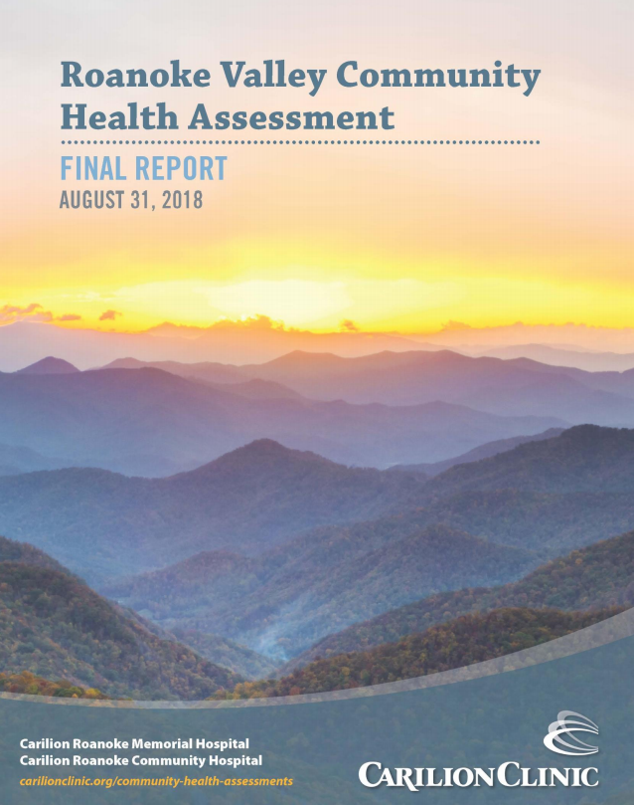
Roanoke Valley Community Health Assessment 2018
Notes:
200 page document available online

Slide 39
Health Assessment Report
Primary data:
Community Health Survey
Stakeholder Survey and Focus Groups
Key Informant Interviews
Areas Assessed
  Community level health concerns
  Individual level health concerns
  Barriers to health, healthcare, social services
Secondary data:
Over 40 sources
Areas Assessed
  Demographics
  Social and economic factors
  Health behaviors
  Clinical care
  Physical environment
  Health outcomes / health status

Slide 40

Target Population and Service Area
Residents living in the Carilion Clinic Service Area
With an emphasis on underserved/vulnerable populations disproportionately impacted by the social determinants of health including poverty, race/ethnicity, education, and/or lack of insurance.

Slide 41
The finding of the 2018 RVCHA revealed 10 priority health-related issues in the community.
1. Poverty / low average household income
2. Transportation / transit system
3. Access:
Mental / Behavioral health services
Substance use services
4. Culture: healthy behaviors not a priority
5. High uninsured / underinsured population
6. Affordable / safe housing
7. Access to dental care
8. Poor diet
9. High cost of care
10. Educational attainment

Slide 42
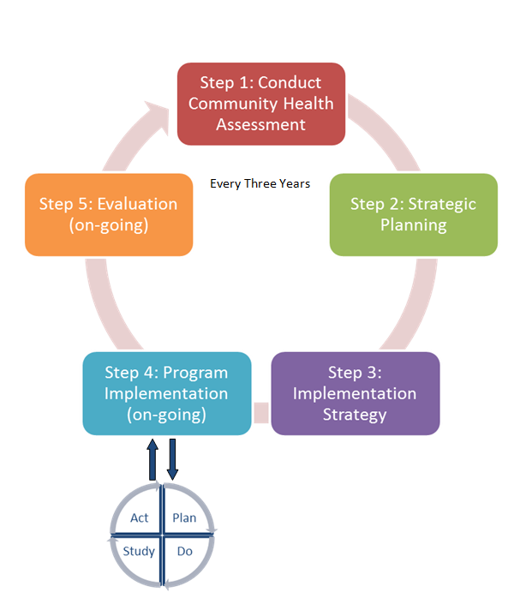
Community Health Improvement
Step 1: Conduct CHA
Step 2: Strategic planning
Step 3: Implementation strategy
Step 4: Program implementation
Step 5: Evaluation (on-going)
Repeats every three years
Guides community benefit investments

Slide 43

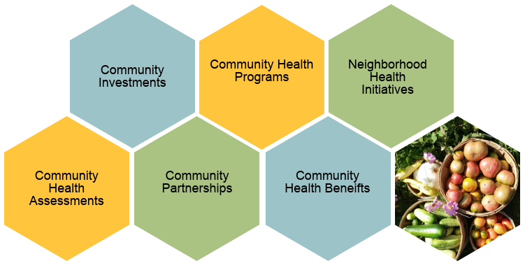
Multidisciplinary Team:
  Admin Support
  Analysts
  Marketing and Communications
  Health Educators
  Dietitians
  Community Health RNs
  Community Health LPNs
  Community Health Workers
  Peer Support Specialist
Notes:
Specifically, I have the privilege of leading the Community Health and Outreach department. Our department manages our community health improvement process which includes our community health assessments. Our health assessment process works collaboratively with community partners to priorities health needs. To respond to those needs, we provide community grants and sponsorships, facilitate and fund community partnerships, operate community health programs, and lead specific neighborhood health initiatives. Our department reports all of the great work we to the federal government in what is called community benefit. In FY17, Carilion Clinic provided 170.7 million in community benefit.

Slide 44


Notes:
Another partnership with HEALTHY ROANOKE VALLEY is our FreshFoods Rx program at our South East and Roanoke-Salem family practices along with New Horizons Healthcare. Physicians write prescriptions for their diabetic patients for fresh fruits and veggies. A local mobile farmers market comes on site once a week so that the patients can pick out their whole foods. Our health educators are on site and cooking demonstrations are held.
Results are promising: More than 60% of the participants decreased their BMI and their hemoglobin A1C. Half of them saw decreased blood pressure.

Slide 45




Notes:
We all are aware of the Opioid crises in our region and the need for more mental health services. Almost a third of participants in our community health assessment surveys identify mental health services as difficult to access because of a lack of availability, fear, and stigma.
Because of this, Carilion’s Psychiatry department, our Community Health and Outreach team and several community partners developed several programs, such as peer-to-peer recovery support, coaching, resource navigation and treatment options for those suffering or recovering from substance abuse or mental health challenges.
5W Inpatient, Inpatient Pscychaity, working on ED-Bridge Clinic. Two full time staff, two part time staff

Slide 46
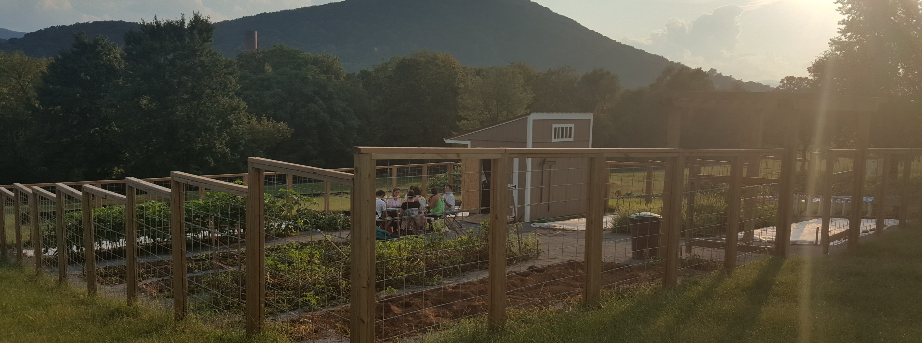

Notes:
Healthy Franklin County is another inspiring coalition, this one focusing on reducing obesity and related chronic diseases. To stimulate interest in gardening and to provide fresh food to county residents who typically rely on food pantries, HEALTHY FRANKLIN COUNTY created a series of raised bed gardens in close proximity to fresh food deserts. Since Spring of 2016, almost 32,000 lbs. of food have been donated .
HENI is a partnership in Franklin County to increase access to care and insurance coverage. Franklin Memorial hired a Community Outreach Advocate to work in the Emergency Room to transition patients who have no primary care physician or insurance to more appropriate and lower cost care. This has resulted in more people becoming insured and a decreasing trend in ED visits.
There are other examples in Lexington and Giles, in rural areas and towns, partnerships inspired by our community hospitals.

Slide 47
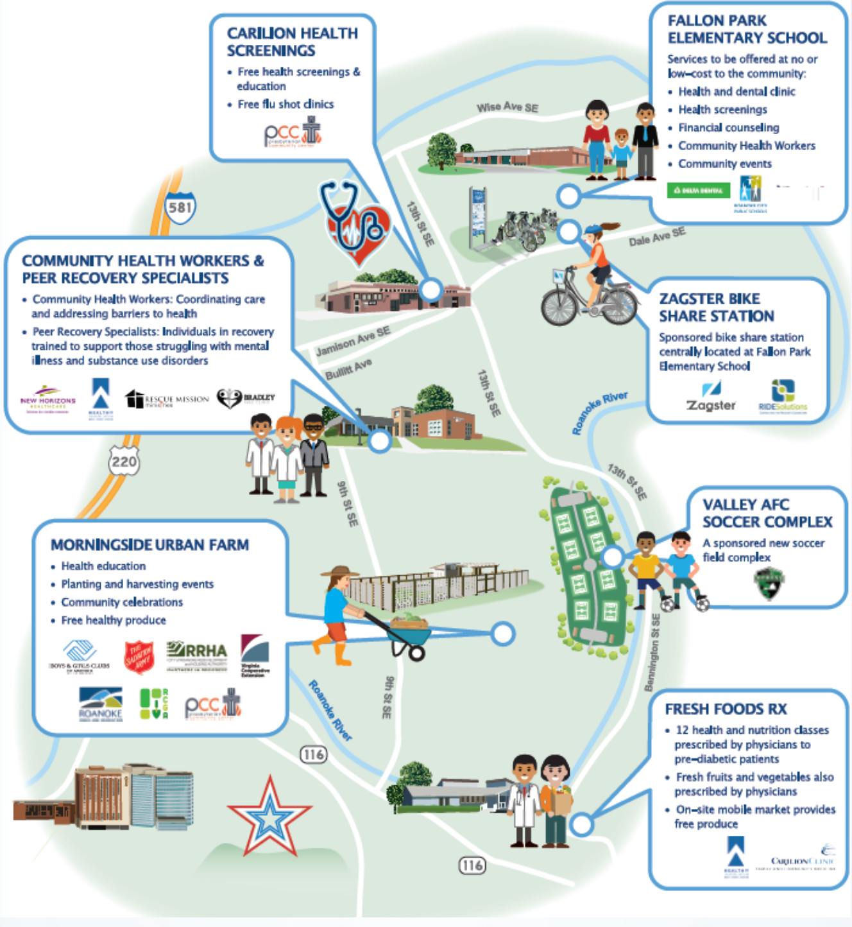

Slide 48
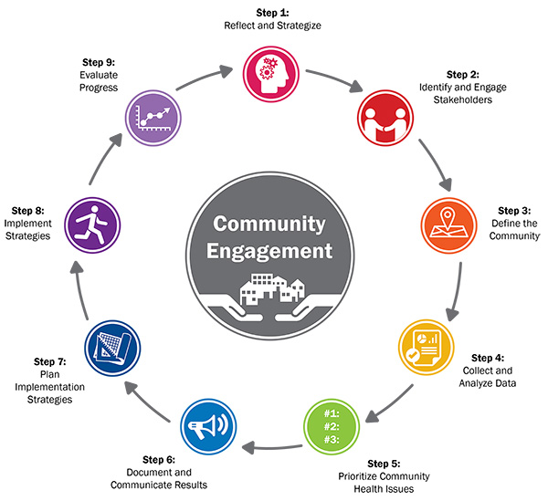
Population health:
Health care and public health Working together to serve our community

Slide 49

Any questions?

