Slide 1
Seven Habits to Create a Positive Learning Environment
Call Me By My Name
Teri L. Turner, MD, MPH, Med
Professor and Vice Chair of Education
Martin I Lorin Endowed Chair in Medical Education
Baylor College of Medicine
Texas Children’s Hospital

Slide 2
I have no disclosures to report.

Slide 3
Notes:
How I became interested in the topic – these are some of my trainees
RAT – stood up and clapped when the resident said “know your student’s name”
Since then, I have heard various issues
It all starts with “who we are” and this begins with our name

Slide 5
“A professor knowing your name makes you feel as if you’re a part of the process, rather than just being swallowed by it.”
- Elaine

Slide 6
Objectives
Discuss behaviors that promote a positive learning environment
Identify important theories from psychology, sociology, medical education and business that underlie these habits
Develop an action plan to promote a positive learning environment at your institution
Notes:
Not an exhaustive review of the MedEd literature but looking at how not only this work but also that done in K-12, business, psychology, and sociology can impact how we frame solutions.

Slide 7
Notes:
Brian, Katie, Jasmine, Linda, Genevie, Monique, Tom. Your name is extremely powerful when spoken. It often has significant familial and cultural meaning.
“Ask yourself: who is the one teacher in your entire life who made the biggest difference for you – who taught you so well that you still think about him or her as your best teacher.”

Slide 8
The Power of Names
Affects learner attitudes about the course
Feel valued, more invested in learning
Affects student behaviors
Help seeking, talking about issues/struggles, perform better
Affects learner perceptions (course and instructor)
Instructor cares, builds relationships and community
Cooper, KM, et al. What’s in a name? The importance of students perceiving that an instructor knows their names in a high-enrollment biology classroom. CBE—Life Sciences Education, 2017.
Notes:
When I feel that person connection with the teacher – it makes me want to do better – it’s almost as if I’m extra accountable – Lloyd

Slide 9
“If they cared enough to remember my name in such a large class, it showed me that they cared about my experience in the class and education.”
- Kaylie

Slide 10
Maslow Hierarchy of Needs
Maslow AH. “Motivation and Personality.” 3rd edition 1987
Notes:
An individual’s response to learning is dominated at any given moment by whichever need has priority.
Maslow’s most famous work was the ‘Hierarchy of Needs’ in which he suggested than an individual’s response to learning is dominated at any given moment by whichever need has priority. The hierarchy of needs is divided into two phases. The lower order needs relate to the physiological and safety aspects of learning. Maslow argued that progression to higher levels is not possible unless the lower-level needs have been met. (Think about trying to learn in a really cold room – you have trouble listening because you are focused on how cold you are).
Physiological: comfort, heating and lighting
Safety: physical and psychological
Higher order needs: belonging: acceptance and mutual trust
Esteem: self-confidence and self-respect
Self-Actualization: realizing potential and desire to grow
Maslow claimed that the motivation to progress through each level can be driven by either extrinsic or intrinsic forces.
Basic needs
Psychological needs
Self-fulfillment needs

Slide 11
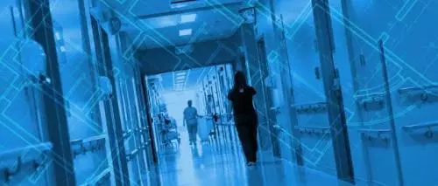
Components of the Clinical Learning Environment
Architectural
Digital
Inclusivity
Educational
Psychological
Sociocultural
Training Home
2018 ICRE Learning Environment Consensus Conference
“The Learning Environment and Residency Education: The Evolution of Training.”

Slide 12
Bynum and Haque. Risky business: psychological safety and the risks of learning medicine. JGME. 2016.
Notes:
Across the United States and throughout the world – there is a day that thousands of medical students magically become a doctor. One day ago they were a medical student wrapped in the protections of their schooling and today – poof – they are a DOCTOR. However – despite the fact they have doctor before their name – they are still in training. Many have not fully developed a professional identity of being a doctor. The concept of Legitimate peripheral participation and development of professional identity

Slide 13
Notes:
I was reflecting on what I tell applicants after their interview – I hope you choose TCH to become your pediatric training HOME.
Concept of a training “home” – more than the hospitals 4 walls and roof, the word “home” evokes many emotions and images. For trainees, home should be a place of safety and security, a place of belonging and nurturance, where individuality, self esteem and confidence grow. Home is the place where trainees evolve into their best selves.

Slide 14
Assessing the Learning Environment
Postgraduate Hospital Educational Environment Measure (PHEEM) [Chan 2016]
Dutch Residency Educational Climate Test (D-RECT) [Boor 2011]
Team Learning and Psychological Safety [Edmonson 1999]
Rating of Toxic Symptoms (ROTS) [Appreciation at Work $]
Ambulatory Care Learning Education Environment Measure (ACLEEM) [Riquelme 2013]
C-Change [Pololi 2017]

Slide 15
7 Habits to Create a Positive Learning Environment
Covey, Stephen R. "The 7 habits of highly effective people: Powerful lessons in personal change." 2005.

Slide 16
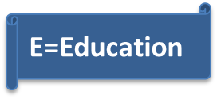
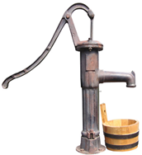
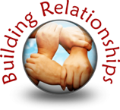
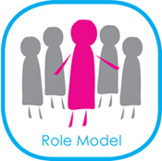
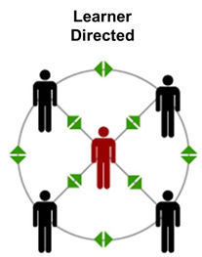
7 habits
Develop Growth Mindset
Put the “E” back in Medical Education
Build Rapport and Team Relationships
Set Learners Up for Success
Be a Super(role)model
Value Learner-Centeredness
Promote a Sense of Value

Slide 17
Habit 1: Develop a Growth Mindset

Slide 18
Rosenthal and Jacobson. Pygmalion in the classroom: Teacher expectation and pupils' intellectual development. 1968.
Notes:
The first psychologist to systematically study this was a Harvard professor named Robert Rosenthal, who in 1964 did a wonderful experiment at an elementary school south of San Francisco.
The idea was to figure out what would happen if teachers were told that certain kids in their class were destined to succeed, so Rosenthal took a normal IQ test and dressed it up as a different test.
"It was a standardized IQ test, Flanagan's Test of General Ability," he says. "But the cover we put on it, we had printed on every test booklet, said 'Harvard Test of Inflected Acquisition.' "
Rosenthal told the teachers that this very special test from Harvard had the very special ability to predict which kids were about to be very special — that is, which kids were about to experience a dramatic growth in their IQ.
After the kids took the test, he then chose from every class several children totally at random. There was nothing at all to distinguish these kids from the other kids, but he told their teachers that the test predicted the kids were on the verge of an intense intellectual bloom.

Slide 19
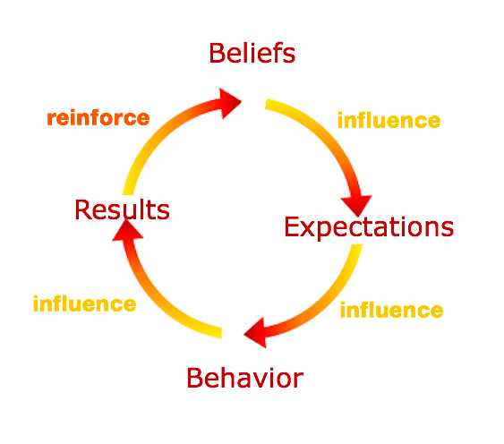
Pygmalion Effect
Rosenthal and Jacobson. Pygmalion in the classroom: Teacher expectation and pupils' intellectual development. 1968
Notes:
The bottom line is that if we expect certain behaviors from people, we treat them differently — and that treatment is likely to affect their behavior,” Our Mindset Can Effect the Outcomes of Others
In this study, the teachers behaved differently in 4 ways:
Climate – they were nicer, input – taught more material to these children, response opportunity – called on them more and they allowed them to talk longer and feedback – both praised more AND gave them more differential feedback when they got it wrong.

Slide 20
Silent Messages Teacher Immediacy Behaviors
Perception of psychological closeness
Nonverbal or Verbal
Nicer
Taught more material
Allowed them to talk more
Praised them more often
Gave more differential feedback
Mehrabian, A. Silent messages. 1971.
Notes:
These teachers BEHAVED differently to those they thought would do well – affinity bias
Audiotape yourself on rounds or with small group teaching – very powerful exercise
Climate – they were nicer, input – taught more material to these children, response opportunity – called on them more and they allowed them to talk longer and feedback – both praised more AND gave them more differential feedback when they got it wrong.
Social psychologist Albert Mehrabian has been credited with defining the concept of immediacy in terms of his "principle of immediacy," which states "people are drawn toward persons and things they like, evaluate highly, and prefer; and they avoid or move away from things they dislike, evaluate negatively, or do not prefer" (Mehrabian, 1971).

Slide 21
Mindset Quiz
Regarding intelligence, what percentage out of 100 is effort and what percentage is ability?
Dweck, C. Mindset: The New Psychology Of Success. 2006.
Notes:
Regarding intelligence, what percentage out of 100 is effort and what percentage is ability?

Slide 22
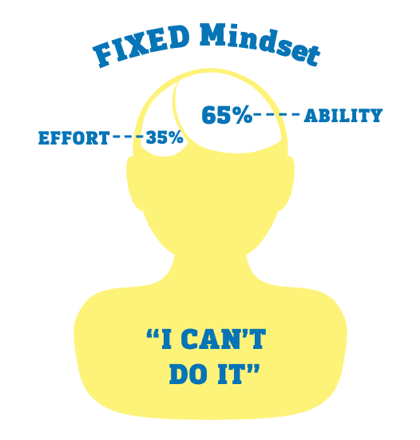
Mindset Quiz
Dweck, C. Mindset: The New Psychology Of Success. 2006.
Notes:
Mindsets are “how we see the world”

Slide 23
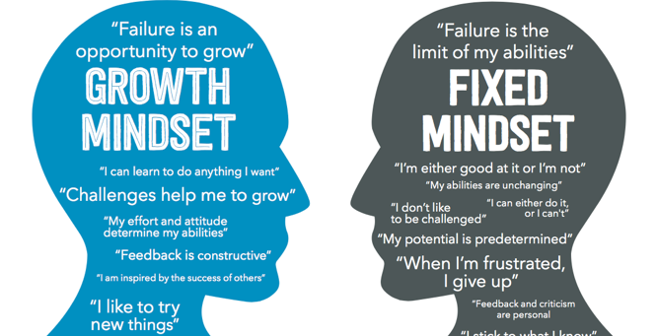
Notes:
Loci of control
Effect of effort
Response to failure or challenges
Goal orientation – mastery vs. performance (be a little better every time – versus I don’t want to look stupid”
More accurate on self-assessment than fixed
View themselves as successful even after failure
View success as more diagnostic of ability
Underestimate success and overestimate failure
Don’t expect successes to continue, feel others would do better on the task
View failure as more diagnostic

Slide 24
Notes:
Failing Forward vs Failing Backward
She’ll never be a pediatric subspecialist. We tried and tried but she just isn’t competent/smart enough.
Her patients loved her – she was stellar at communication

Slide 25
Actions: Promote a Growth Mindset
Teach about growth mindset
Promote improvement and self-mastery goals
Reflection-on-action
One thing you will do again next time
One thing better
Praise for effort, process, strategy, commitment, resourcefulness
Discuss your own journey and share stories of failure
Notes:
Perfection is our enemy
Praise for effort and not ability (you are a naturally gifted teacher – versus you worked really hard)
Interventions can temper the effect of poverty on academic achievement and help at-risk students1,2
Teaching growth mindset before college narrows racial, ethnic and socioeconomic achievement gaps3
Love of learning4

Slide 26
Habit 2: Put the “E” Back in Medical Education
E=Education

Slide 27
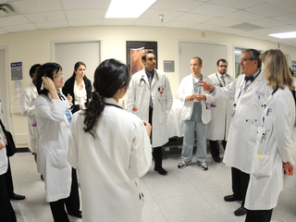
E=Education
Clinical Learning Environment Review from the Accreditation Council of Graduate Medical Education: https://www.acgme.org
E=Education
Notes:
Begin with the end in mind
I don’t have a clue what my learners are experiencing – “taking a walkabout” – Flexner
Add the ACGME CLER work and the CLEW
Work compression

Slide 28
Service versus Education
E=Education
E=Education
Kesselheim, JC., et al. "Balancing education and service in graduate medical education: data from pediatric trainees and program directors." Academic Medicine. 2014.
.
Notes:
25% of all responses on the 2018 annual ACGME survey for pediatrics were not in compliance with the question: “Education not compromised by excessive reliance on non-physician obligations.”
Not practicing at the top of one’s skill set. “I’m just a scribe”
Mismatch of perceptions

Slide 29
The Work Environment and Burnout
Work overload
Lack of control
Insufficient reward
Unfairness
Breakdown of community
Value conflict
E=Education
Maslach & Leiter. “The Truth About Burnout: How Organizations Cause Personal Stress and What to Do About It.” 1997
Notes:
As one’s training year progresses the “micro” risks one takes in the learning environment accumulate, “meta” risks may emerge, including the potential to feel burned out, depressed, socially withdrawn, less empathetic and ready to quit medicine altogether.
The identification of six domains of the work environment that affect employee burnout:
Value – education and relationship with patients

Slide 30
“Autonomy gives you a sense of purpose. That you are making decisions and growing as a clinician. There’s going to be so many things outside of your control, but if you are allowed to have control, safely, within your realm of what is expected and safe for the patient so that you can grow, I think that’s important”
“It was that lack of control over what I was doing and over the decisions about patient care that I realized in retrospect really made it unpleasant for me. Not just that I wasn’t able to make any decisions, but that no one was even interested in hearing about the decisions that I might make, which was frustrating.”
Soon to be published research, Zuniga L. et al Baylor College of Medicine

Slide 31
Finding Meaning in Work
E=Education
Notes:
Talk about continuity and tell Linessa’s story – Where is MY doctor?

Slide 32
Actions: Put the E back in Education
Use “walk-abouts”
Revisit the “why”
Spend more time at the bedside
Decrease time on non-clinical and administrative tasks
Enhance continuity with faculty
Challenge (and change) “old” models of training
E=Education
Hipp, DM, et al. "“Back to Bedside”: residents' and fellows' perspectives on finding meaning in work." JGME. 2017.
Notes:
Revisit personal statements
Not just “our governing body makes us do this”
One promising strategy to mitigate physician burnout is to foster meaning and joy in work through systematic changes in the clinical learning environment.
Reflected on how your work helps make the world a better place – national mean in pediatrics was 3.6/5
Was eager to come back to work the next day 3.8/5
You felt connected to your work in a deep sense 3.9/5

Slide 33
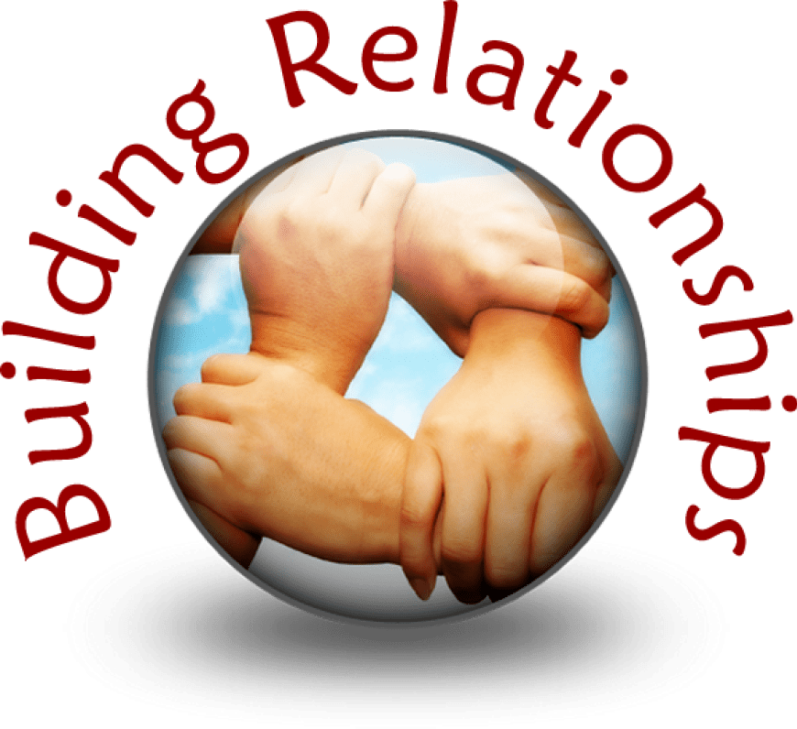
Habit 3: Build Rapport and Team Relationships
The Josiah Macy Jr. Foundation. Improving Environments for Learning in the Health Professions. http://macyfoundation.org
E=Education

Slide 34
“We are learning and we make mistakes. We are always 10 times more frustrated and embarrassed for our faults than you are.”
- Keerthana

Slide 35
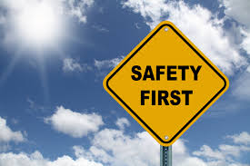
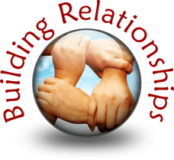
Psychological Safety
Torralba, and Puder. Psychological Safety Among Learners: When Connection Is More Than Just Communication. JGME 2017.
Bynum and Haque. Risky business: psychological safety and the risks of learning medicine. JGME. 2016.
Notes:
The construct of psychological safety deals with the degree to which learners perceive their work environment as conducive to engaging in behaviors that have inherent intrapersonal risk.
Torralba et al gave residents who rotated through a Department of Veterans Affairs health care facility the Learners’ Perceptions Survey from 2011-2014 (4 years of data). The LPS contains 84 satisfaction questions has been given annually by the Office of Academic Affiliations since 2001. 84 questions on a 5 point Likert scale on 9 domains describing a trainee’s VA teaching, working and clinical experiences for a given academic year. There is also asked a summary overall satisfaction after each domain. “Members of the clinical team of which I was a part are able to bring up problems and tough issues.” (computed a response-bias index – are they hawks or doves” (13,000 of 43,000 residents completed – 30% response rate) – only 1 question assessed psychological safety
Men had higher psychological safety, less complex, “other” medicine (psychiatry) – no association to level of training. This included feeling PS and satisfaction with the learning environment, faculty and perceptions, personal experience, and systems and processes.
PS is highly related to increased team engagement, increased rates of medical error reporting, personal work engagement, and quality system improvement.

Slide 36
“Stand up in front of peers and staff and present. You are then asked probing questions to identify gaps in your knowledge. You get feedback on your performance (usually only when you are doing it poorly or wrong). You feel like you are under a constant microscope”

Slide 37
Hierarchies and Implicit Biases
Banaji, Mahzarin R., and Anthony G. Greenwald. Blindspot: Hidden biases of good people. 2016.
Notes:
Risks to PS – unnessary risks such as learner mistreatment, punitive responses to error, derision within teams, and hierarchical oppression.
Tell the story in the book blindspot . (A father and his son are in a car accident. The father dies at the scene and the son, badly injured, is rushed to the hospital. In the operating room, the surgeon looks at the boy and says, “I can’t operate on this boy. He is my son.” How can this be?
Hierarchies – Romana talked about hierarchies today. I have implicit biases and the team members I work with each have implicit biases. How do we learn to take a time out and gather information that contradicts those biases.
Consider telling story about how all the men were AOA – when infact none of the men were AOA but the one female was.
Get rid of behaviors such as mistreatment, humiliation, harsh pimping, uncivil behavior, shaming, exaggerated power differentials, and intergenerational derogation. Hierarchical RITES of PASSAGE

Slide 38
IMPOSTER
Notes:
Show that feelings of not belonging are widely shared. Made to recognize how common those feelings are among peers
Belonging interventions

Slide 39
IMPOSTER
Notes:
Get to know each other as individuals
And yes, this is me, as you can see my interest in teaching came from a very early age, here I am teaching my pet monkey “Zippy” the finer art of toilet training. I have also dressed up as Lady Gaga for our intern retreat.
In the process of getting to know them you’re communicating that you care about them and their success

Slide 40
Actions: Build Rapport & Relationships
Build relationships first
Promote psychological safety within the team
Eliminate hierarchies
Reflect on implicit biases
Share personal stories to promote belonging
Get to know your trainees (and let them know you)

Slide 41
Habit 4: Set Learners Up For Success
E=Education
Notes:
Talk about icon – this corresponds to Coveys’ – Think Win-Win

Slide 42
Draw a vehicle
(Take one minute to do this on the colored notecard in or near your chair)
Notes:
Rocket – I’m from Houston NASA – space people – astronauts. How did it feel

Slide 43
“Please set expectations at the beginning… instead of waiting for us to do something wrong before saying how you want it done.”
- Saud

Slide 44
Priming the Learner: Setting Expectations
Orienting the learner to the patient prior to the encounter
Clinical documentation
How to present a patient
Time to complete tasks
Reading on patient problems
Professional behaviors
Notes:
Patricia Lye in 1998. 40% of experienced clinician-educators did this and only 50% after the intervention.

Slide 45
“Please remember I want to be doing the right thing the right way.”
- Eve

Slide 46
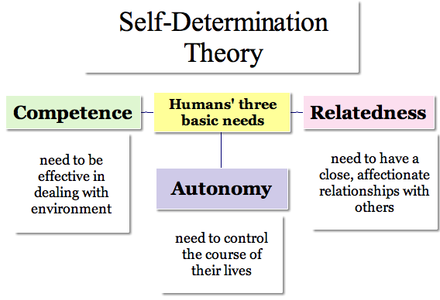
Ryan and Deci. American Psychologist 2000
Kusurkar and ten Cate. Academic Medicine 2013
Lyness et al. BMC Medical Education 2013.
Notes:
Learner motivation – trainees want to be competent

Slide 47
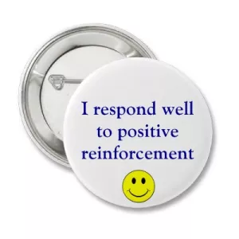
Catch Learners Doing things Well
Hierck, Tom. Seven Keys to a Positive Learning Environment in Your Classroom. 2017.
Notes:
Catch learners doing things right
We are quick to give feedback on what people do wrong – but less on what they do well.
4:1 ratio and when you are first with a learner – you likely will need to give only positive reinforcement initially
Audiotape a teaching session and count the times (you gave positive reinforcement {good job} does not count) and how

Slide 48
Notes:
I don’t expect you to know the answer
I don’t expect you to do it perfectly or even well the first time
It will seem like you are doing worse before you get better

Slide 49
Kendall ML et al. The learning environment for junior doctor training—what hinders, what helps. Medical teacher. 2005.

Slide 50
Actions: Set Learners Up for Success
Set clear expectations and link to learning objectives
Prime the learners, give them the scaffolding to succeed
4:1 positive reinforcement : corrective feedback
When giving feedback, give learners time to improve
Coach for improvement
Individualize curricula and learning environments

Slide 51
Habit 5: Be a Super (Role) Model
Passi V, et al. Doctor role modelling in medical education: BEME Guide No. 27. Medical teacher. 2013.
E=Education
Notes:
Seek first to understand and then to be understood (Covey)
Only thing I have control over is my behavior and my attitude. Career choice – Jason, personal development. If you ran into a trainee 5 years from now.

Slide 52
Notes:
Trainee made the staff cry. People usually don’t behave poorly unless something else is going on. Generous assumptions – give them the benefit of the doubt – show kindness and model the behavior you want to see.

Slide 53
Promote a Feedback Culture
Ramani S, et al. Twelve tips to promote a feedback culture with a growth mind-set: Swinging the feedback pendulum from recipes to relationships. Medical teacher. 2018.

Slide 54
Predominance of Learning through Role-modeling
More profound learning in the implicit (hidden) curriculum
5 out of 6 ACGME CLER focus areas
Health care quality was learned more explicitly
Learning hindered by what was not seen
Passive enculturation and culture (Trainees “picked” things up)
Balmer, DF., et al. "Learning across the explicit, implicit, and extra-curricula: an exploratory study of the relative proportions of residents’ perceived learning in clinical areas at three pediatric residency programs." Academic Medicine. 2015.
Notes:
Hidden curriculum is not always bad
Very little extracurriculum

Slide 55
Workplace Incivility
Negatively affects
Well-being
Individual and team performance
Cognitive tasks
Helpfulness and prosocial behavior
Slavin, SJ., and Chibnall JT. "Mistreatment of medical students in the third year may not be the problem." Medical teacher 39, no. 8 (2017): 891-893
.
Notes:
) “incivility breeds incivility” and it must have a permissive workplace culture to flourish.
Andersson and Pearson (1999) define workplace incivility as “low intensity deviant behavior with ambiguous intent to harm the target, in violation of workplace
norms for mutual respect. Uncivil behaviors are characteristically rude and discourteous, displaying a lack of regard for others” (p. 457). According to Treen (2017), incivility
encompasses a wide range of behaviors including, but not limited overt behavior such as: dismissive body language, talking over others, making jokes at someone’s expense, being
rude to customers or suppliers and using rough language or criticism. More subtle forms of incivility present as: passive-aggressive comments, being routinely late for meetings,
gossiping, carrying on a private conversation or texting during a meeting, withholding information, or excluding people. Other authors have asserted that hostility, sarcasm,
condescension, ignoring and making demanding remarks are also acts of incivility.

Slide 56
Actions: Be a Super Role Model
Be intentional with role modeling
Role model feedback seeking behavior
Have your role modeling peer-reviewed
Demonstrate reflection-on-action
What went well
What I will do better next time
Discuss role modeling experiences (successes AND failures)
Bhansali P, et al. How to be a super model: using role modeling to become an exemplary educator. MedEdPORTAL. 2014. https://doi.org/10.15766/mep_2374-8265.9899

Slide 57
Habit 6: Value Learner Centeredness
E=Education
Notes:
Synergize

Slide 58
Notes:
We want to teach – their learning

Slide 59
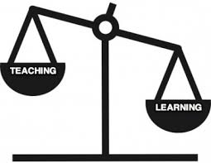
Empowerment
Friedlander MJ, et al. What can medical education learn from the neurobiology of learning?. Academic Medicine. 2011 .
Brown PC, Roediger III HL, McDaniel MA. Make it stick. 2014 .
Weimer, M. Learner-centered teaching: Five key changes to practice. 2002.
Notes:
Shifts the balance of power

Slide 60
“People don’t change their behavior unless there is a reason to do so.”
- Sharon

Slide 61
External control
external feedback
lack of control
threat
emotion -
“bad me”
Internal control
my data to use
“I’m in control”
opportunity
emotion-confidence
Facilitator: listen, accept, motivate, coach
Sargeant J et al. Facilitated reflective performance feedback: developing an evidence-and theory-based model that builds relationship, explores reactions and content, and coaches for performance change (R2C2). Academic Medicine. 2015 Dec 1;90(12):1698-706.

Slide 62
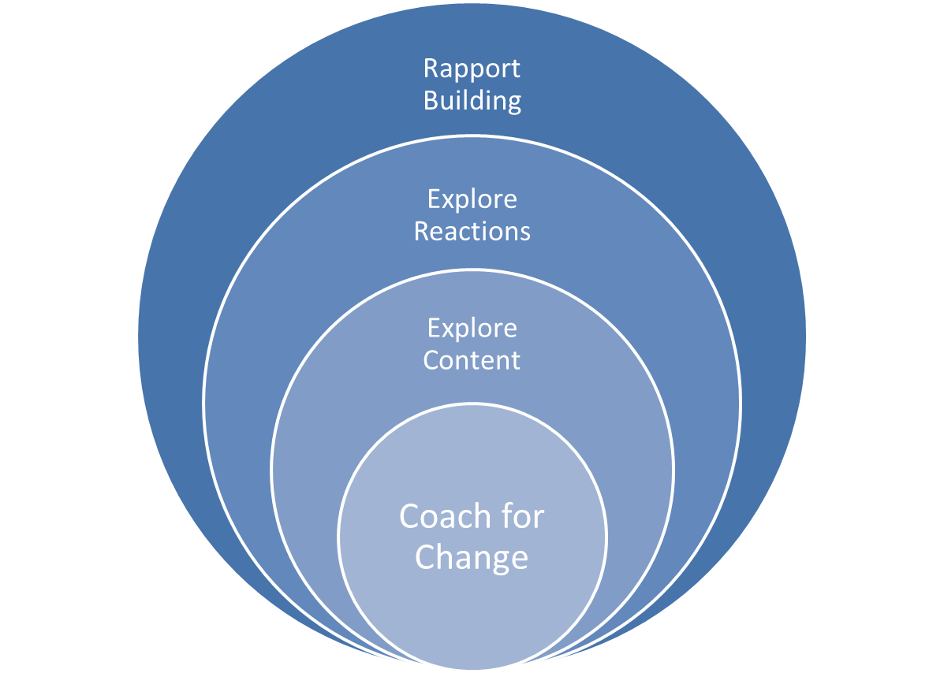
R2C2 Model: Facilitated Reflective Feedback
Sargeant J. et al. https://www.mededportal.org/publication/10387/
Notes:
Emily

Slide 63
Actions: Learner Centeredness
Let the learner express his or her own management plans
Identify what trainees would like to learn
Utilize R2C2 method for facilitated feedback
Encourage reflection
Stop talking about how good learners have it now or how bad or good it was “in my day”

Slide 64
Habit 7: Promote a Sense of Value
E=Education

Slide 65
“Next to physical survival, the greatest need of a human being is psychological survival, to be understood, to be affirmed, to be validated and to be appreciated.”
- Franklin
Notes:
Psychological survival
Improved relationships
Job satisfaction
Increased work engagement

Slide 66
The 5 Languages of Appreciation
Chapman, Gary, and Paul E. White. The 5 languages of appreciation in the workplace: Empowering organizations by encouraging people. 2011.

Slide 67
Words of Affirmation
Context
One-on-one, on rounds, written communication, public affirmation
Types
Praise for accomplishments
Affirmation of character
Affirmation of positive personality traits
Authentic
Be specific in the affirmation, especially how it impacts you or the patient
Don’t forget to use their name

Slide 68
“One of my attendings on PHM actually did this very well, where she had one day of the week where at the end of rounds she randomly made us go around the circle and tell each other something that we appreciated that another team member did that week.”
- Victoria

Slide 69
Quality Time
Types
Focused attention
Doing things together as a team
Shared experiences
Personal connections
Empathetic listening
Please take even 2 minutes out of your day to know more than just my name. [First year pediatric trainee]

Slide 70
Acts of Service

Slide 71
Tangible Gifts and Physical Touch
Gift cards or tickets to an event
Candy
Leaving early
High fives or fist bumps
“Its not even big things. Its more tangible, like food. When people bring us food its like “Oh I realize that you are working hard and I appreciate you.”

Slide 72
Actions: Promote a Sense of Value
Learn your team members primary appreciation language
Show appreciation to one co-worker per week
Put appreciation on your schedule
Keep track of how often you show appreciation
Don’t solely use words of affirmation
Incorporate social noon conferences
Post “Top 10 Easiest Ways to Express Appreciation”
Notes:
What we schedule, we normally do

Slide 73
Plan for Action

Slide 74
7 habits
Develop Growth Mindset
Put the “E” back in Medical Education
Build Rapport and Team Relationships
Set Learners Up for Success
Be a Super(role)model
Value Learner-Centeredness
Promote a Sense of Value

Slide 75
What can I do
Survey
Take a “Walk”
Encourage a movement (Appreciation in the Workplace)
Study bright spots
Innovate and pilot
Be a positive role model
Leverage the trainee’s voice

